Slide 1
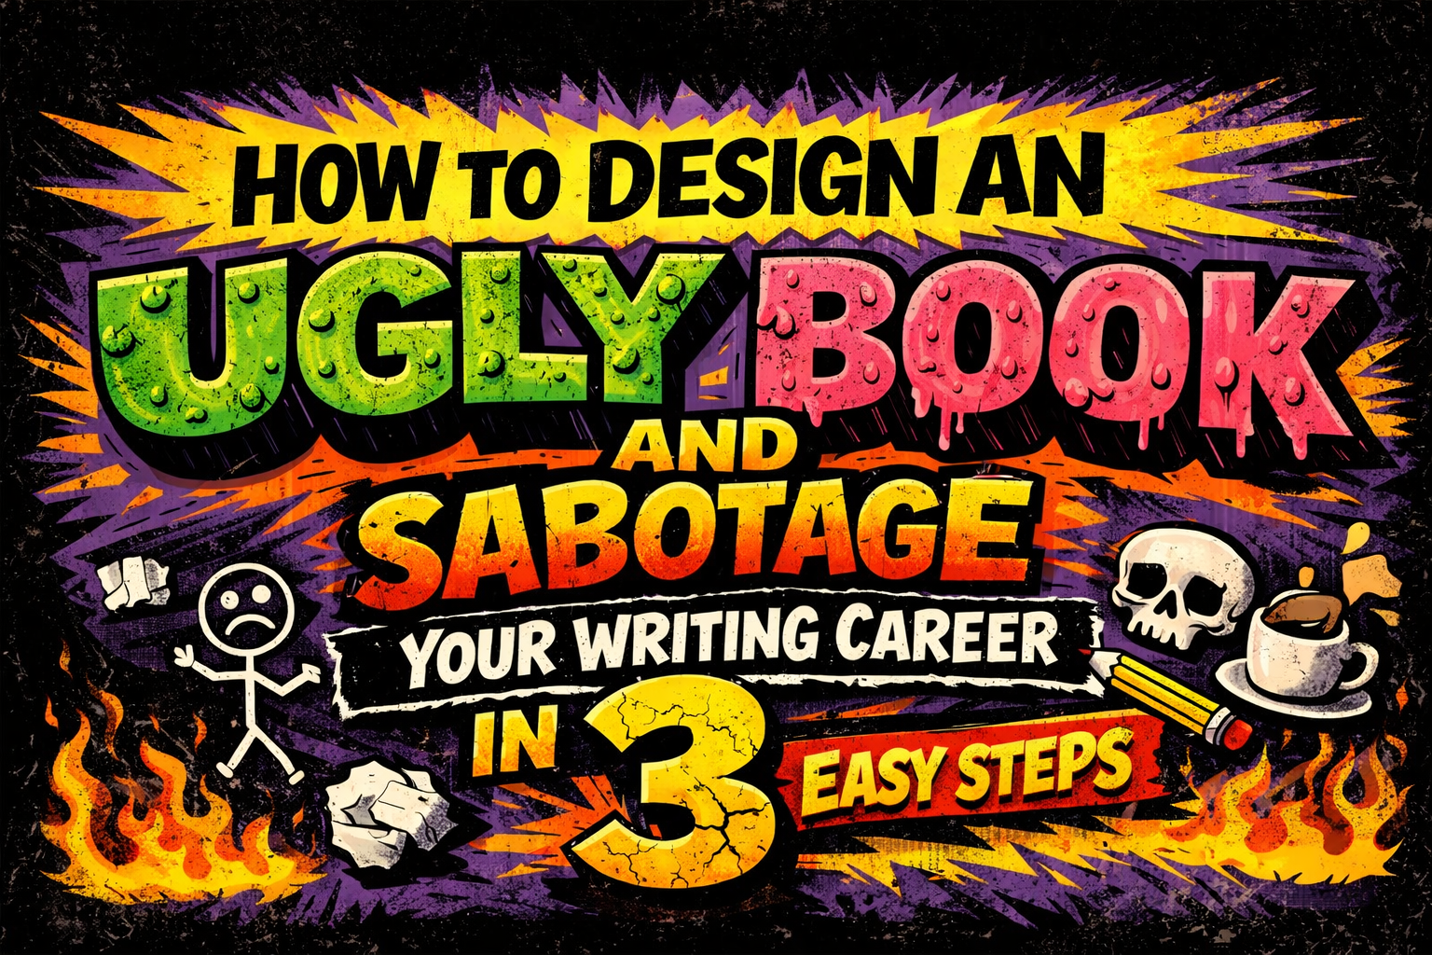

Slide 2
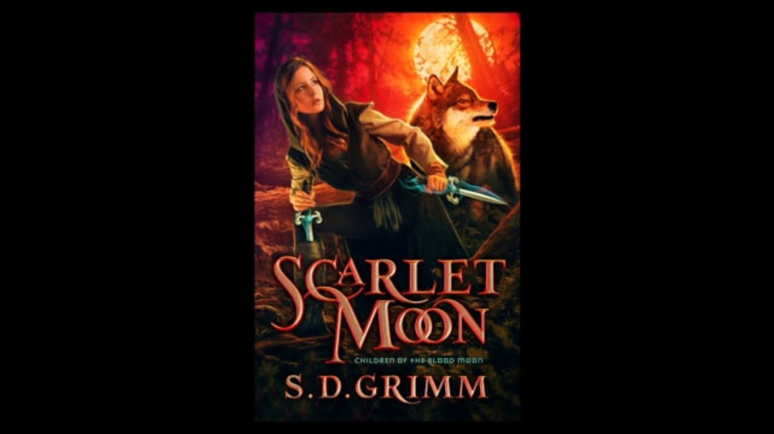

Slide 3
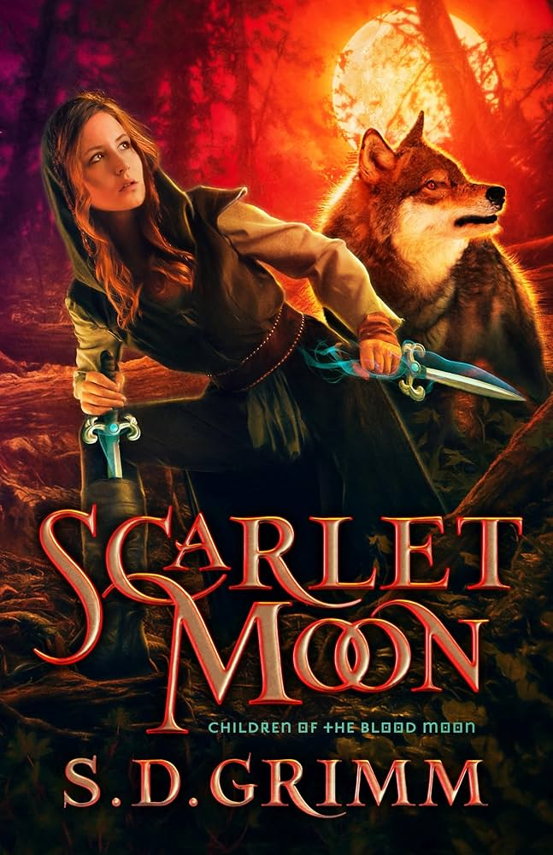

Notes:
Kirk DouPonce

Slide 4

Notes:
Confession time. By show of hands, who secretly judges books by their covers?

Slide 5

We judge books
by their covers
because it indicates
QUALITY.
Notes:
If an author or publisher has invested in an awesome cover, they probably also have invested in the story.
So yes, a good looking cover does tend to indicate a good book. We all inherently know this to be true.

Slide 6




BY DAY, many hats
Marketing Director & Creative / Art Director
Typesetter / Interior book designer
Consultant for authors
Diaper maiden
(currently raising tiny humans)
Notes:
I wear many hats, but my tallest hat is being a Marketing or Creative Director for an ad agency and publishers including Thomas Nelson, Enclave Publishing, and The Christian Writers Institute.
At Enclave, I directed 6 cover artists and made design decisions to adhere to our brand.
I’ve also consulted for New York Times bestselling authors including the Christy estate
But I’m currently a diaper maiden for my surprise baby, which is why I stepped down from my leadership role and am currently just freelancing as a typesetter and interior book designer, and…

Slide 7

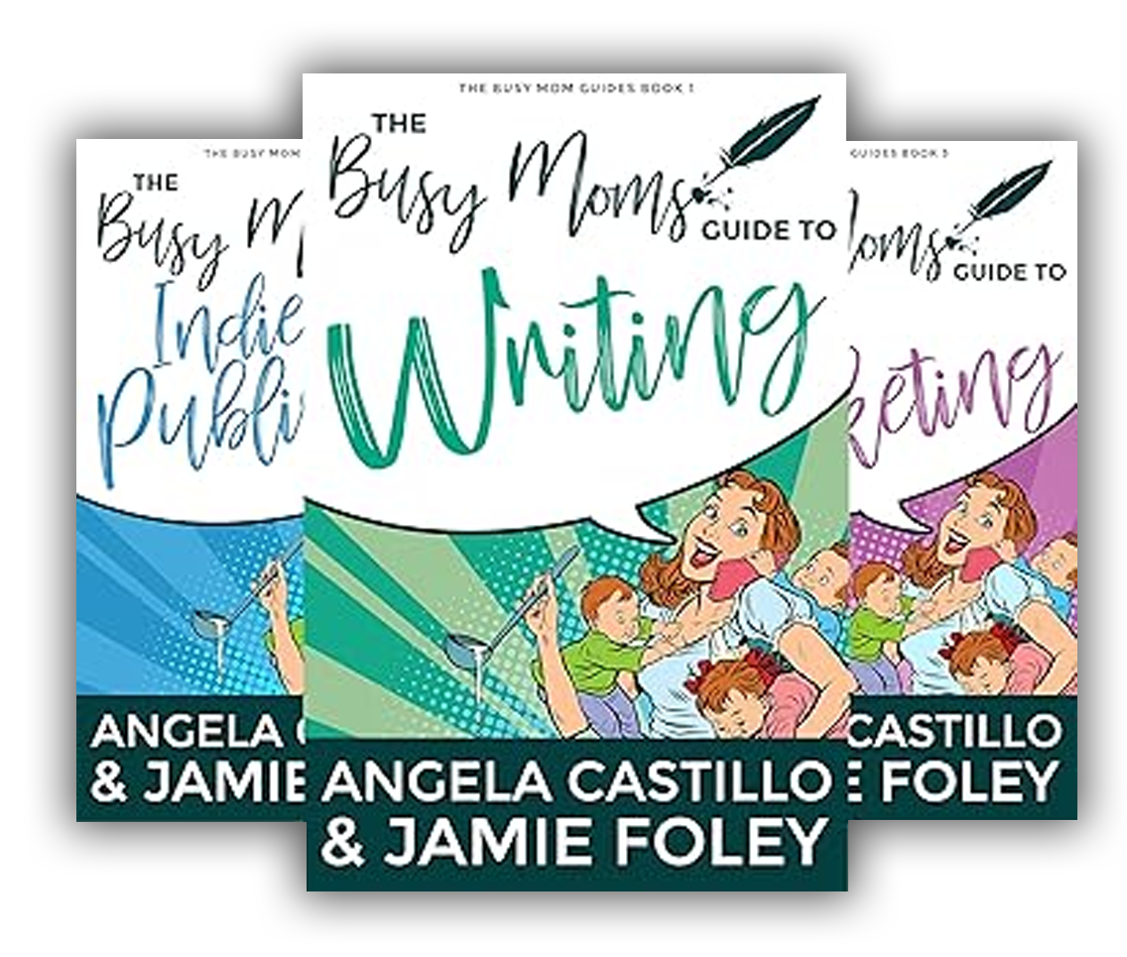

BY NIGHT, many bats
Award-winning sci-fi/fantasy author of 12 books
Non-fiction author of helpful books for authors:
The Busy Moms Guides series
Founder of Fayette Press
Notes:
By night, I’m an award-winning sci-fi/fantasy author of 12 independently published books
Three of those are non-fiction books for authors, The Busy Moms Guide series, which holds all of my nuggets of wisdom, and are available for sale in the hallway
I’m also the founder of Fayette Press, a brand for indie authors of clean sci-fi/fantasy books

Slide 8

Notes:
Let’s play a game where you all will choose between two books.
I will give you an example of a situation you’re in, then flash two book covers on the screen for just a couple seconds.
Then I will ask RIGHT or LEFT, and y’all shout out if you would choose to buy the book that was on the right, or the book that was on the left.

Slide 9

Notes:
You’re a businessman about to go on a long flight. Your plane boards in 5 minutes and you still have to walk to your gate, so you don’t have time to read descriptions—only covers. You only want to spend the money to purchase one book. Which book do you buy?

Slide 10

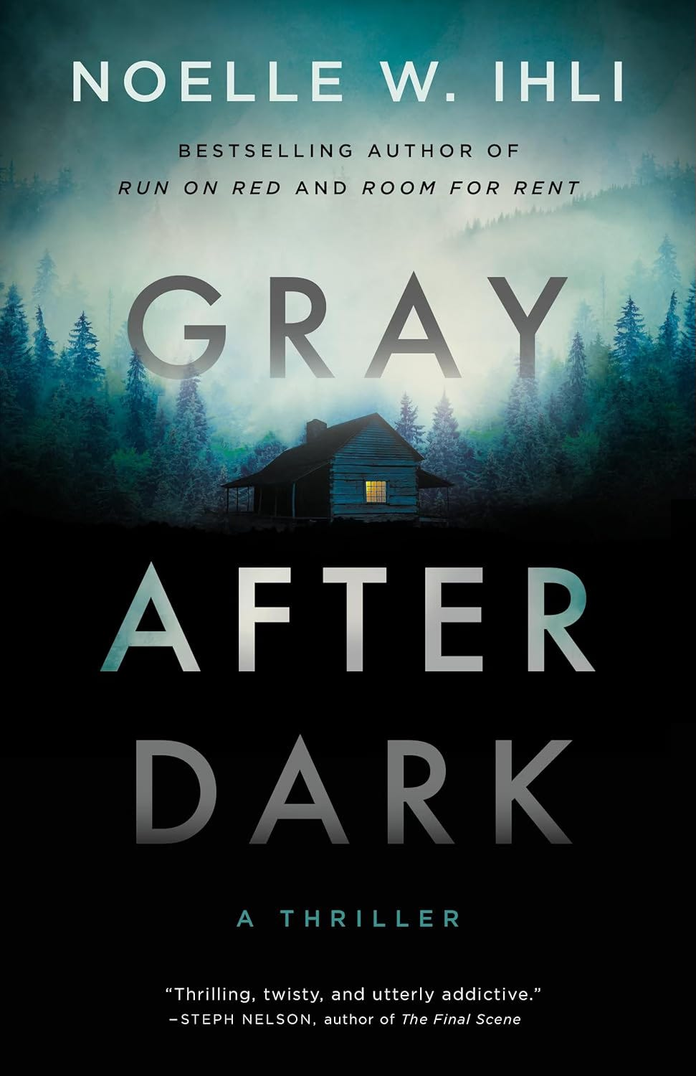

Slide 11
Right
Or
left?

Slide 12
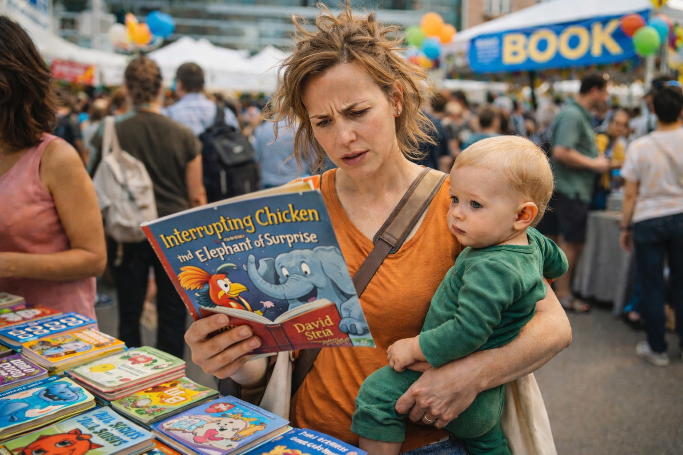
Notes:
You’re a busy mom determined to buy a book for your child. You’ve only been at this book f estival for half an hour and haven’t visited every author’s booth yet, but there’s something sticky in your hair and you smell a poopy diaper. Which book do you buy?

Slide 13



Slide 14
Right
Or
left?

Slide 15
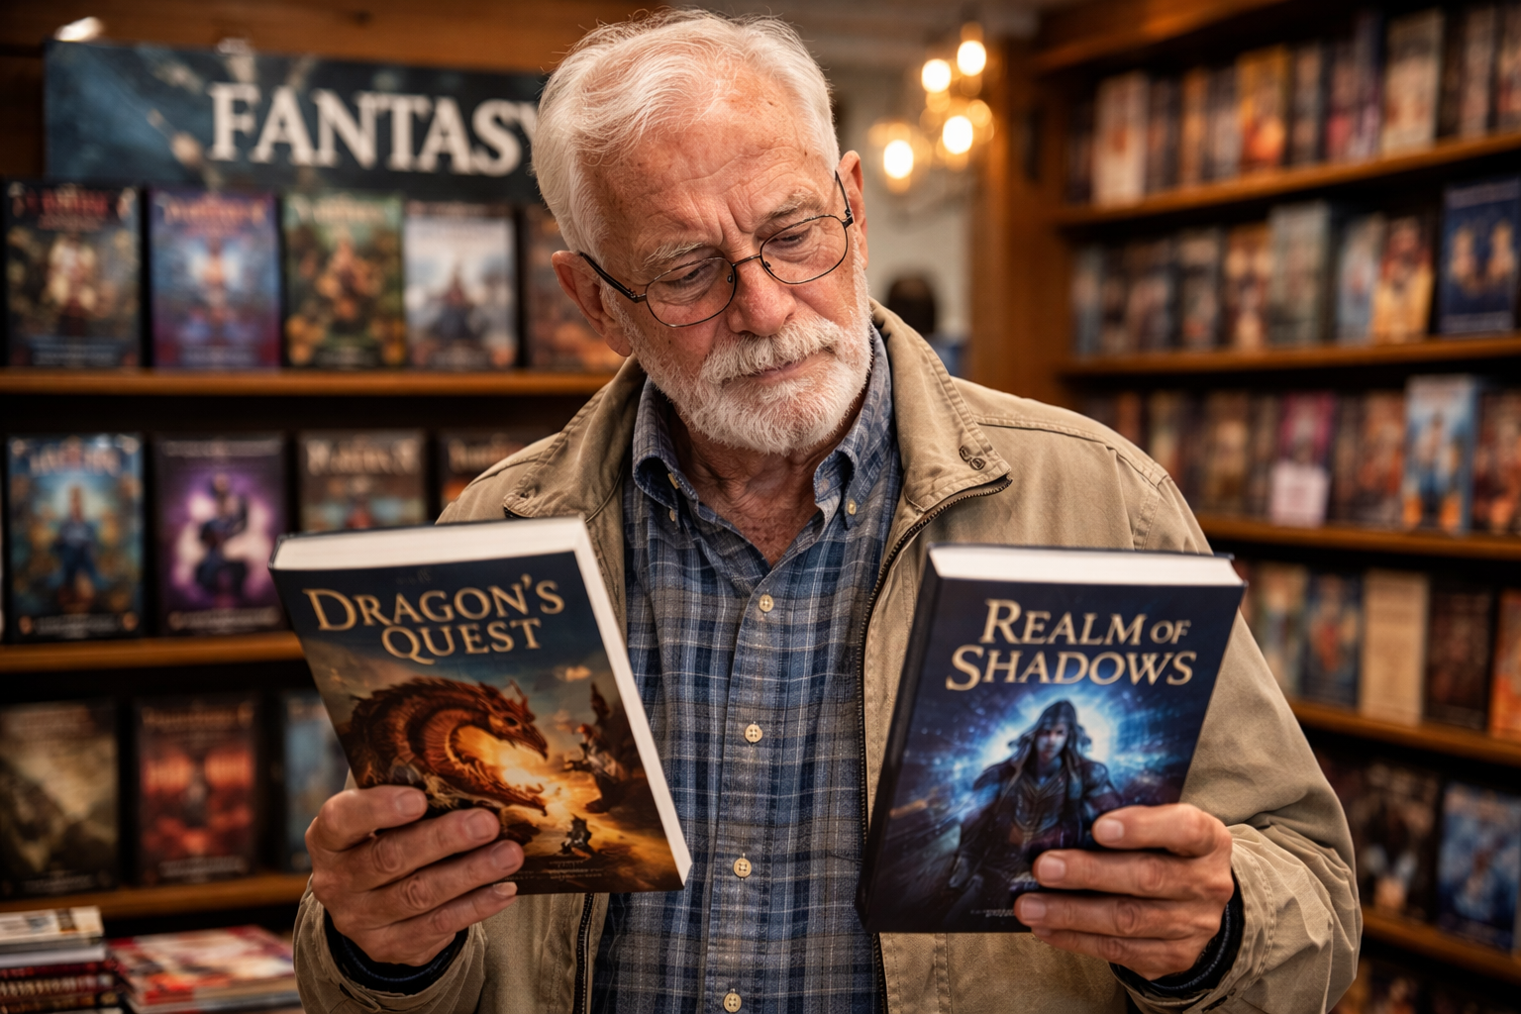
Notes:
You’re a retiree and you want to buy a book for your teenage grandson for his birthday. You stop by the bookstore but have no idea what to buy--you only know he likes books with swords and dragons. Which book do you buy?

Slide 16
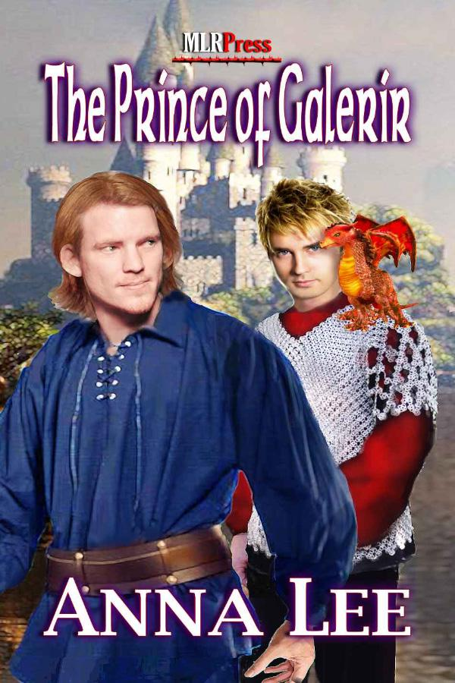
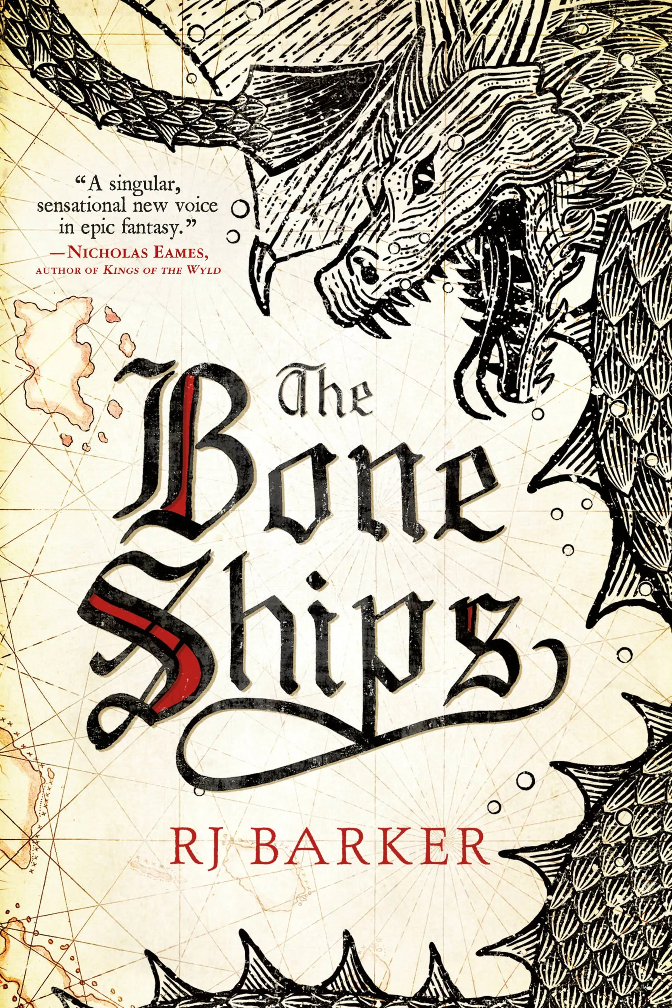

Slide 17
Right
Or
left?
Notes:
What have we learned? Was there a consensus?
People DO judge books by their covers, and good design will make the difference between which book gets purchased, and which book gets left on the shelf.

Slide 18
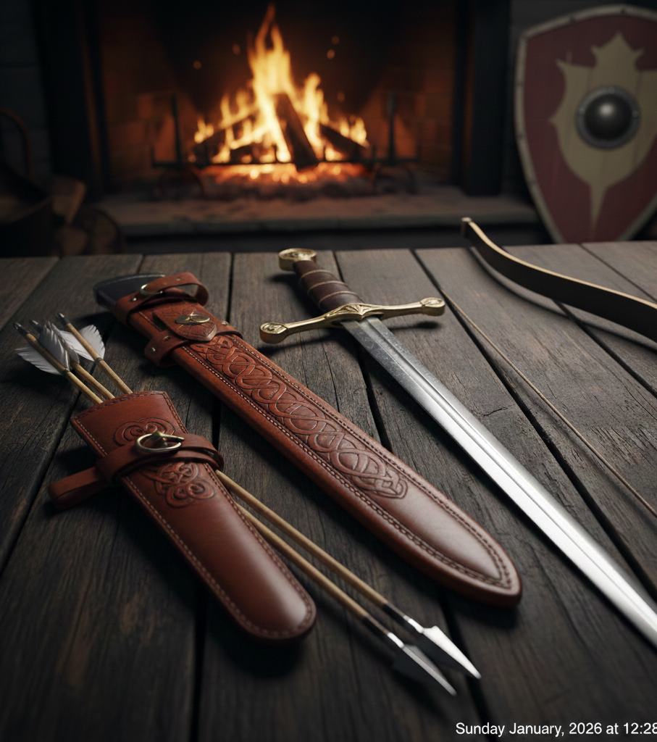
The cover is
your book’s
Greatest
weapon
against its competitors
and its
Greatest
advocate
in the marketplace.
Notes:
The cover is your book’s greatest weapon against its competitors, and its greatest advocate in the marketplace.

Slide 19

Notes:
I'm not going to teach you how to design a cover. I'm going to teach you how to identify a good cover from a marketing perspective.
So you will have the tools and informed perspective to help your publisher or your designer craft a cover that will sell your book.

Slide 21

STEP 1:
Be cheap.

Slide 22

Cheap
Cover
=
Instant
Credibility
loss
Notes:
If the cover looks amateur—muddy colors, bad typography, unclear genre signals—people assume the writing is equally rough.

Slide 23

Notes:
Hobbyist vs Businessman

Slide 24

Target audience?

Slide 25

If you are going to
be asking people
to pay money
for your book,
then your book is a
Product.

Slide 26
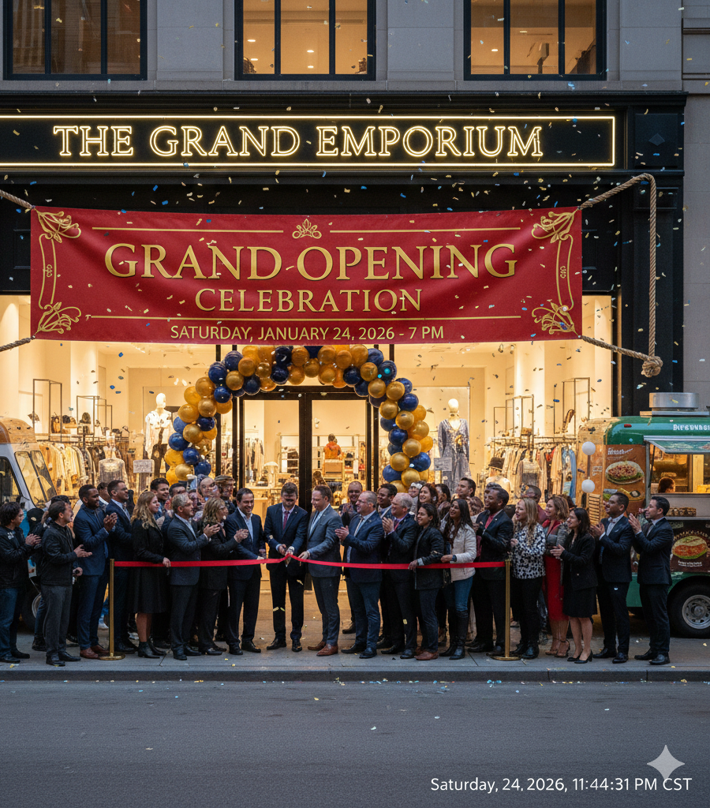
Average Startup Cost for a new business
Home-based/Microbusinesses:
$2,000 - $5,000
Online Businesses:
$3,000 - $10,000
Service Businesses:
$5,000 - $25,000
Storefront/Retail Businesses:
$100,000+

Slide 27
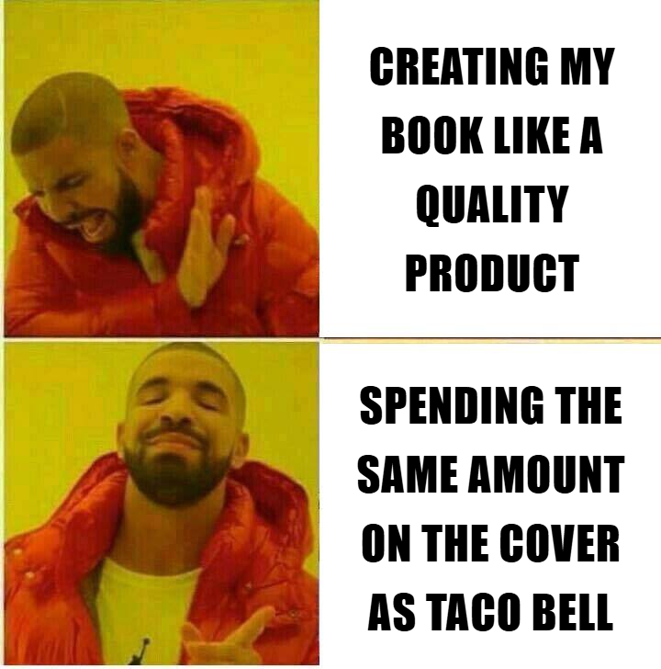

Slide 28

Dreaming about writing a book:
5 years
Planning and outlining the book:
1 year
Writing the book:
1 year
Editing the book:
9 months + $1,000
Setting up branding, website, author photos, writing software, etc.:
Blood, sweat, and tears
ISBN, formatting, publishing costs:
$500 and more tears
Marketing promos, interviews, reviews:
$1,000 and some gray hairs
Going cheap on
the single greatest factor
for your actual book sales
(AKA your book cover):
Priceless.

Slide 29


Slide 30
Goals of a
business-minded writer:
Turn a browser into a buyer,
then turn the buyer into a fan.
Notes:
Fans buy our first book they fall in love with, then they’ll buy the next one, and the next one . . .
With consistent excellence in book publishing, our audience will grow and grow, until we have our own little empire that provides reliable income for each new book release.

Slide 31
The Outside.
The book cover.
The synopsis.
. . .
. . .
Oh, and at an in-person event:
3. the author’s first impression
What
turns
a
Browser
into a
Buyer?

Slide 32
The Inside.
Great writing & editing
Promises kept/Trust
“Gotta have the next book!”
Interior design & overall quality
The author’s behavior & interactions
Consistency
What
turns
a
Buyer
into a
fan?
Notes:
But none of this can happen without the book cover attracting the buyer in the first place.
So putting effort into all these areas is a waste without a good book cover.

Slide 33
Goal of a
book cover:
Attract and intrigue the viewer enough
to make them pick up (or click on) the book,
then start reading the synopsis.
Notes:
A book cover has completed its job when the reader picks up the book and turns it over to read the back cover or open to start reading the first page.

Slide 34
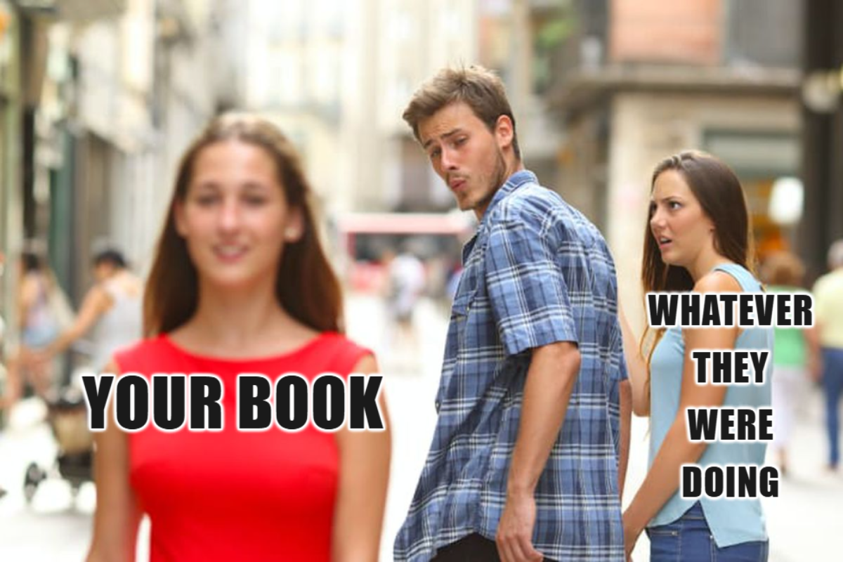
Get
Noticed
Stop the stroll
Stop the scroll
Notes:
Stand out from the crowd, attract attention.

Slide 35

Communicate
the
Correct
SubGenre
And
Theme/feel
Attract the right readers
Repel the wrong ones

Slide 36
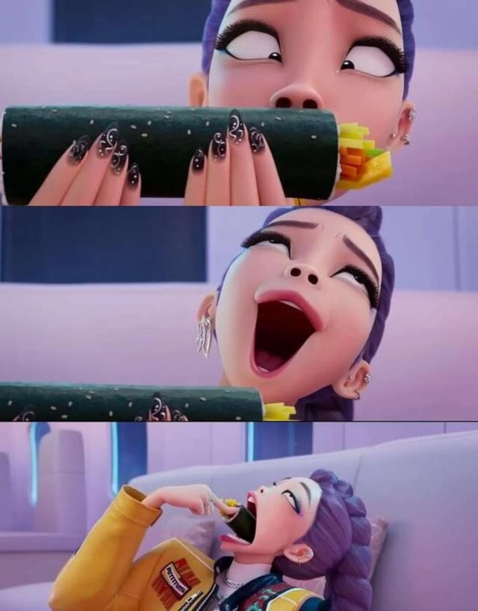
Spark
Intrigue
& Desire
Create a visual hook
based on the genre’s
emotional promise
Notes:
Each book makes an emotional promise.
Romance - happily ever after
Non-fiction - Learn hidden gem of amazing or helpful truth
Sci-fi/fantasy - Epic adventure with evil defeated in the end
Thrillers - expect tension, blood pressure up

Slide 37
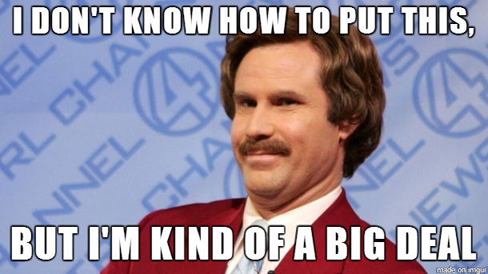
Brag.
Endorsements
Author bestselling/
award-winning status
Shiny award emblem
Notes:
Don’t brag about yourself. Let your book cover do it for you.

Slide 38
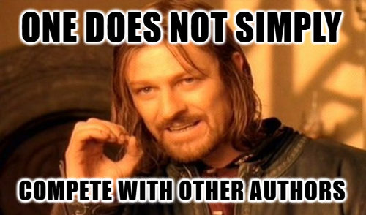
Notes:
We cannot possibly write and publish as fast as our fans read.
So we share fans with other authors and help market each others’ books.
Promote the books of author friends who share your target audience, and when your next book comes out, they will repay the favor.

Slide 39
STEP 2:
Kneecap Your artist.

Slide 40
Decoration
The author’s
self-expression
Artistic experimentation
A
Book
Cover
Is
NOT:
Notes:
Unless you are a hobby writer

Slide 41
Book Design
is not about
what the author likes.
it is about what the
target audience craves
in the genre
they love.

Slide 42
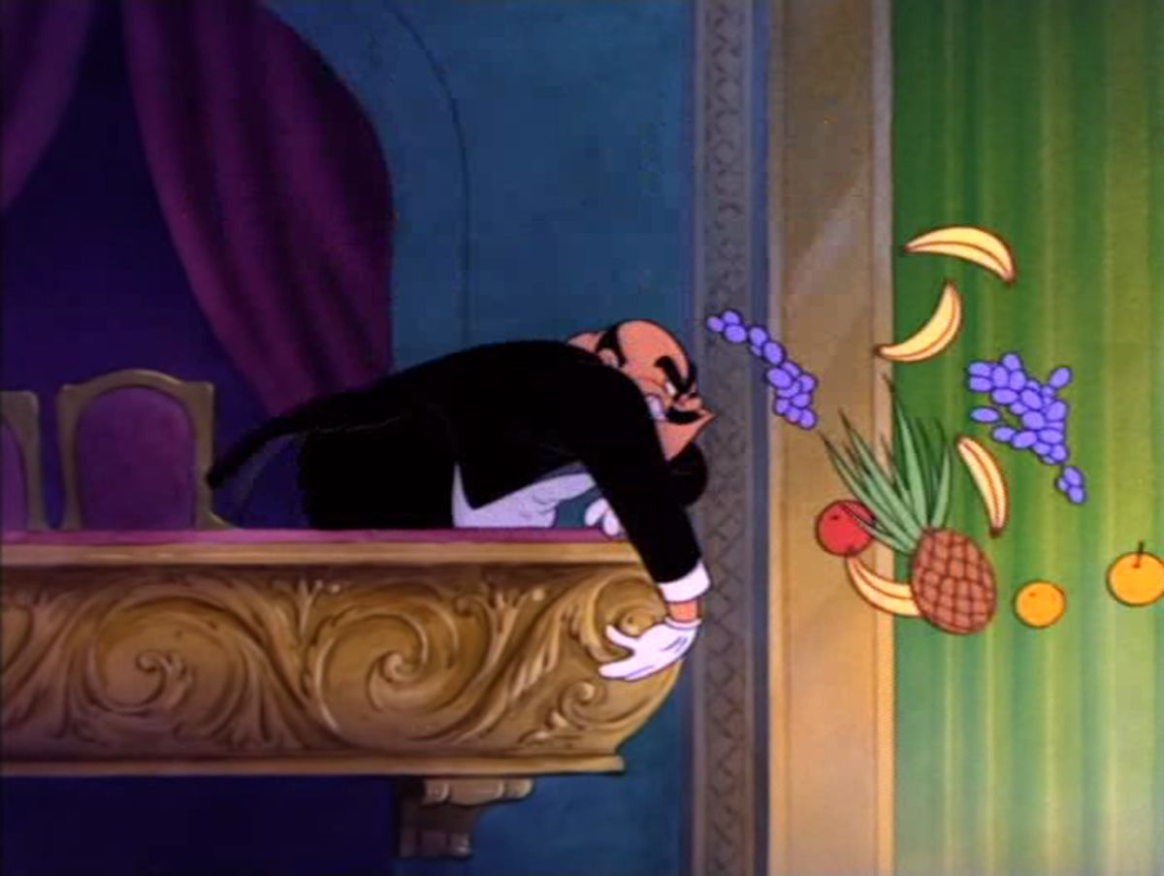
Notes:
Hold your tomatoes!
I’m trying to help sell your book.
Trust me and listen, and if you still want to throw your tomato by the end, we can set up a dunking booth or something.

Slide 43
A “cliché” cover
that hits its
target audience
is a marketing success.
A “beautiful” cover
that doesn’t sell
is a failure.

Slide 44
Great Art
doesn’t always make
A Great cover.
Notes:
So then, should we just spend tens of thousands of dollars on every book cover? No!
Great art doesn’t always make a great cover.
Let me teach you discernment.

Slide 45
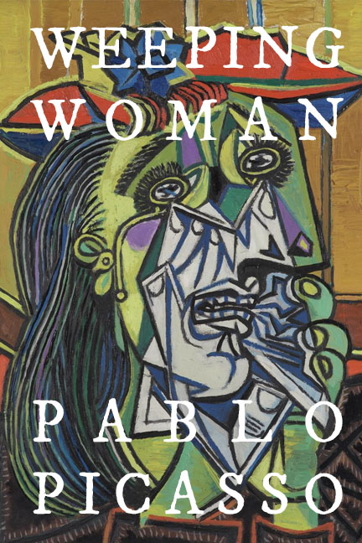

Slide 46
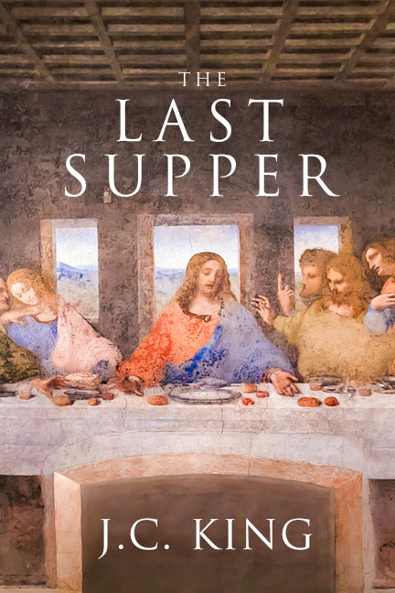

Slide 47
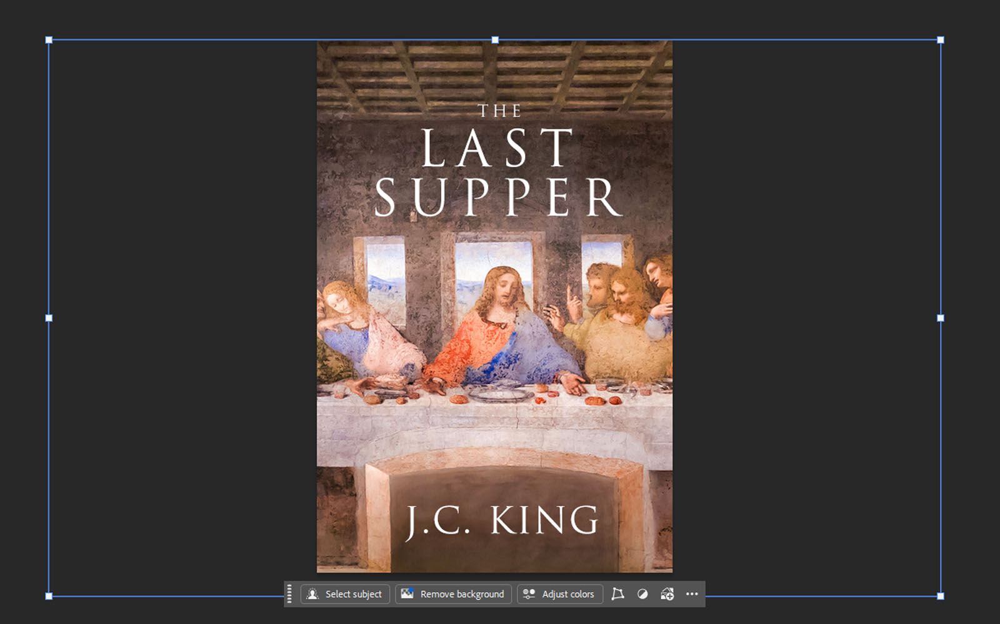

Slide 48
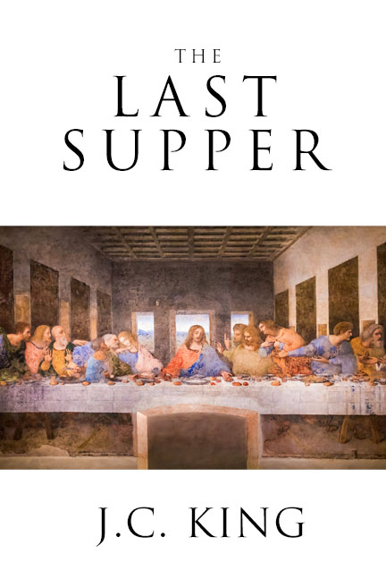

Slide 49
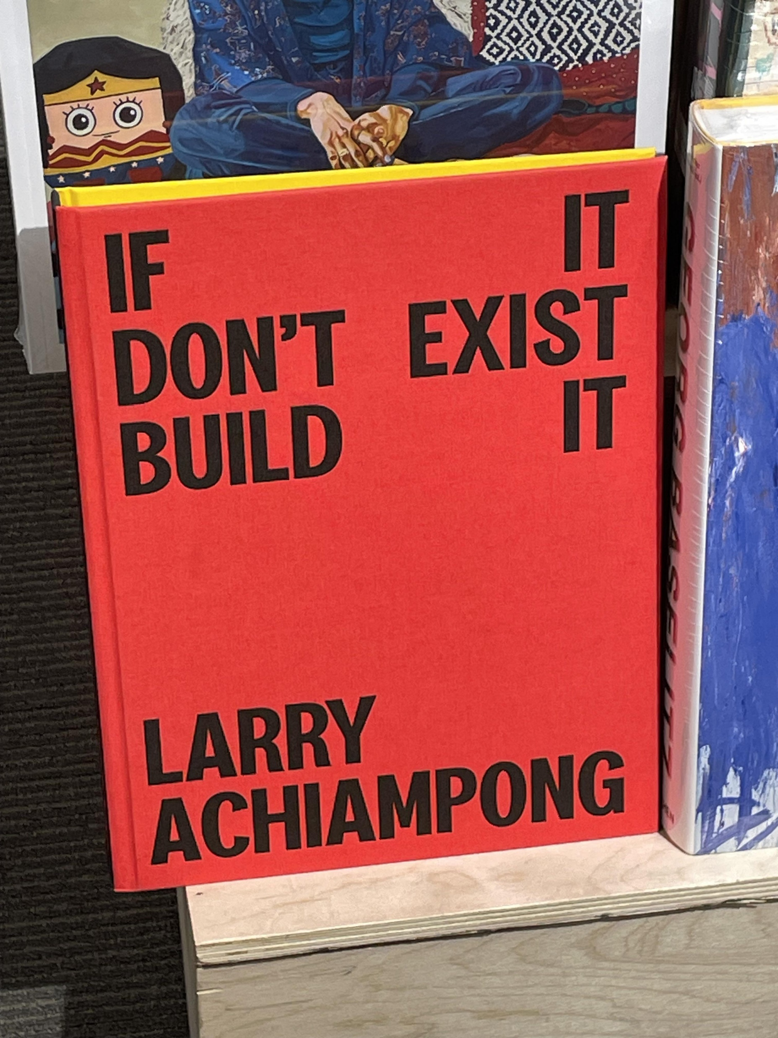

Slide 50
A book cover
is not Art
for contemplation.
it is a tool for
Persuasion
under extreme
time pressure.
Notes:
Unless you’re a hobby writer.

Slide 51
The #1 job
of a book cover is to
sell the book, not
make the author happy.
Notes:
Don't get in the way of a good cover design with your feelings. Unless you are a hobby writer.

Slide 52
Secondary objectives:
To be the author’s personal favorite flavor of art
(must not compromise
the primary objectives)
Notes:
Of course we WANT the author to love their book cover.
This secondary objective must be achieved, just so long as it doesn’t hinder the primary objectives.

Slide 53
Secondary objectives:
2. To have every excruciating detail exactly as pictured in the author’s minds eye
(must not compromise
the primary objectives)
Notes:
If those details are really important to you, hire a concept artist to get all those details exactly as you want them.
Then provide that to your cover designer or publisher.
Or prompt AI until it makes slop that vaguely resembles what you want, then give it to a real human artist, just to more easily communicate what you want.

Slide 54
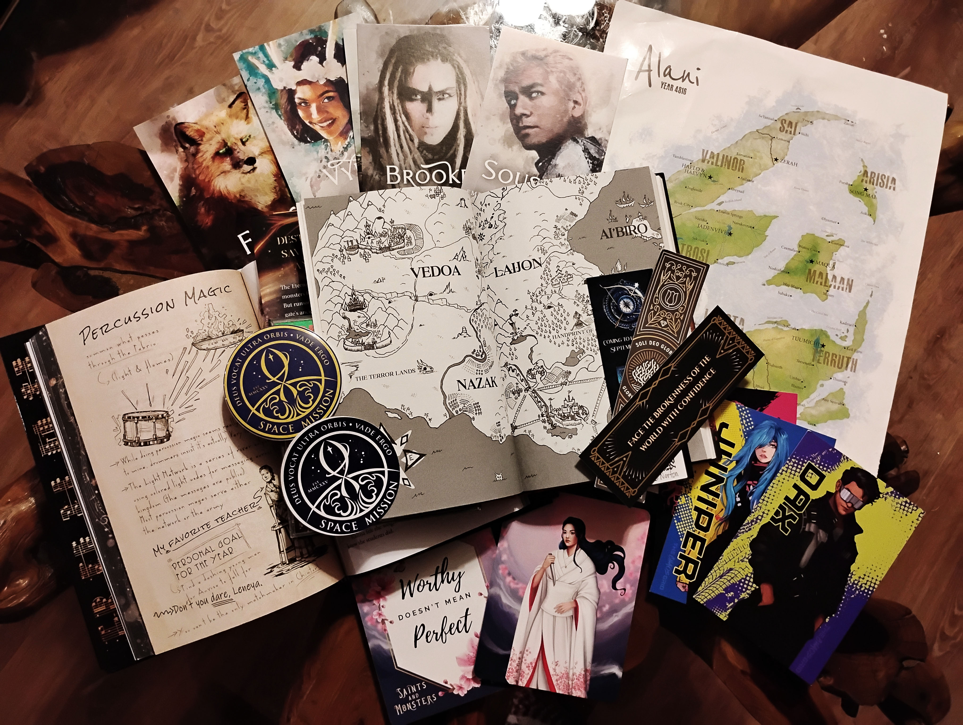
Notes:
Discussion questions, recipes, tea bags, cookie mix

Slide 55
Secondary objectives:
3. To be so breathtakingly gorgeous that it’s an instant buy
(must not compromise
the primary objectives)
Notes:
Why is this not a primary objective?
Because the buyer will not become a fan, so it doesn’t help the author’s long-term career goal.
It’s just one purchase.

Slide 56
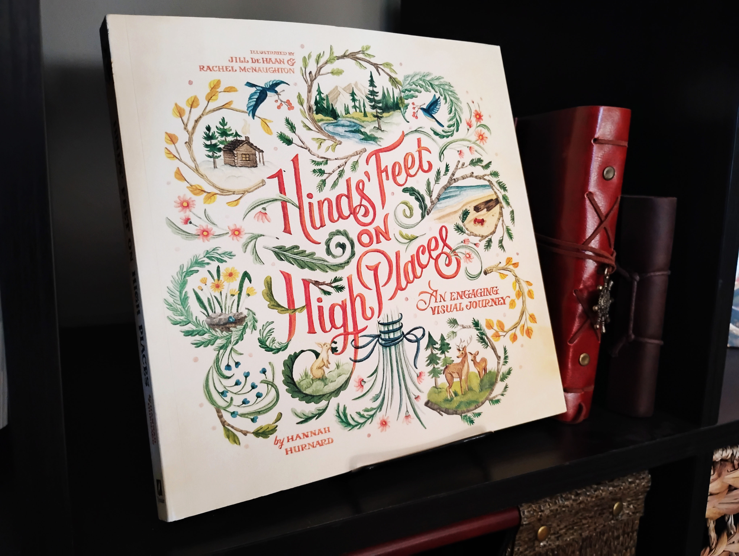
Notes:
Insta buy just for the cover is great, but if buyers don’t actually read it, then the author doesn’t actually have any new fans to buy the next book.

Slide 57
1. Look professional – More worthy of the buyer’s money
than that other book that screams
“self published”
How
To
achieve
All
Of
these goals?
Notes:
THIS IS WHY WE PAY A PROFESSIONAL BOOK COVER DESIGNER. They are specialist. They have that star quality.
Your friend’s nephew’s cousin who’s going to art school is not specialized in book cover design.
And even if he is, he’s still in art school, so he’s not a professional yet.

Slide 58
2. Be legible – Especially from afar
How
To
achieve
All
Of
these goals?

Slide 59
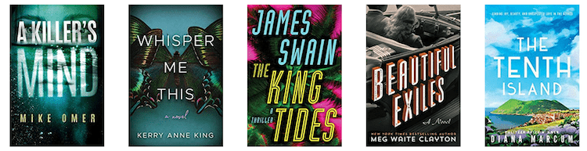

The Thumbnail Test

Slide 60
3. Not too busy – Because your book cover shouldn’t look like Where’s Waldo
How
To
achieve
All
Of
these goals?

Slide 61

Too many colors,
fonts, or complexity
in the artwork
Too many different things being communicated
Lack of focus
The
Busy Problem

Slide 62

Don’t cram it full of details – A cover isn’t a summary of the book, it should create curiosity through mystery. If your cover is trying to explain the plot, it’s already failed.
Less is more
Utilize high contrast – Gray & homogenous vs black & white, bold colors
Take advantage of negative space

Slide 63

How to speak designese
Hire a good cover designer and then trust them to do their job.
Find examples of covers that you like. Provide 3-6 examples. This will simultaneously educate you on the market and be very helpful to your artist.
Lower your expectations for the first draft. The designer is just spit balling at the beginning. It’s not going to look final and polished yet.
Be patient with your artist–they can’t read your mind.

Slide 64
How to speak designese
Provide your publisher/designer with specific things you like and don’t like.
Be respectful to your artist. You might be working with them for the sequel, too.
Wait 24-48 hours before you respond. Let it marinate. Ask fellow authors what they think or put up a poll on a Facebook group full of fans of your genre. Do A/B testing, asking for feedback.
Put all of your requested changes together in a single batch rather than sending 12 different emails/requests.

Slide 65
STEP 3:
Target the wrong genre.
Notes:
What do you do while the cover designer is working?
Your job as the author is to ensure that the cover accurately represents your story and its genre, thereby targeting your ideal reader.

Slide 66
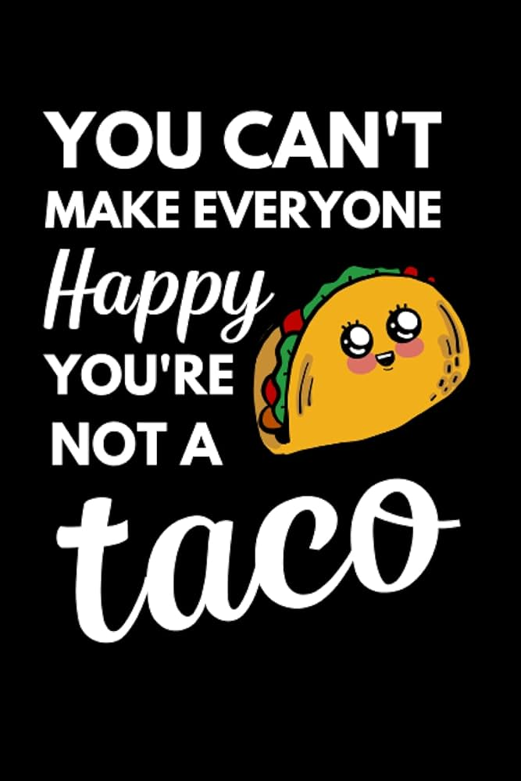
Notes:
Your book is not for everyone. It should be written to cater specifically to the superfans of its specific subgenre.
Identify your ideal reader and aim to please them. The better you serve your very specific audience, the more appealing it will become to a wider audience.
Example: Harry Potter. Paul’s letters to Ephesus, Corinth, the church in Thessalonica. Now the Bible is the most bestselling book of all time and those cities and nations don’t even exist anymore.

Slide 67
CONFUSION
kills sales faster than
Bad taste.
Notes:
If people can't tell what genre your book is, or if it’s too generic, they are less likely to pick it up or click on it.

Slide 68
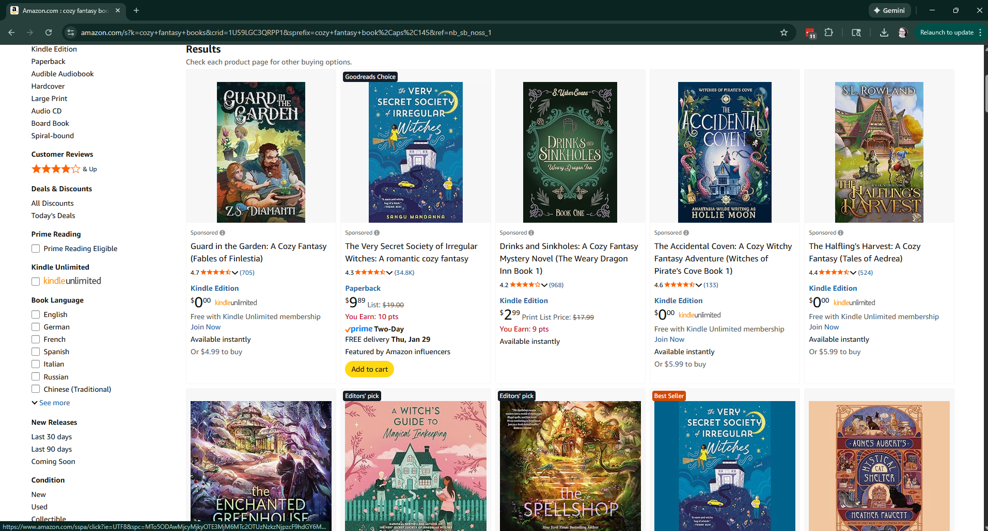
Notes:
Pull up your specific subgenre’s page on Amazon. Notice all the things in common.
This example: “Cozy Fantasy Books.”
- Pastels, no harsh or bright colors.
- Fonts are rounded, sans-serif, modern.
- Many homes and inns – cozy feel.
- Decorative frills, especially foliage.

Slide 69
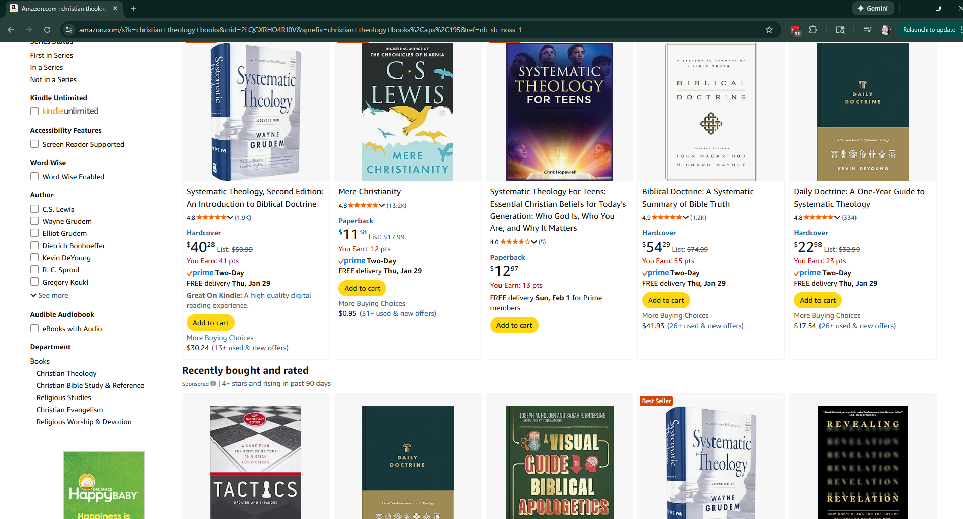
Notes:
This example: “Christian Theology Books.”
- High contrast whites and darks, no bold colors
- Use of negative space
- Very clean look

Slide 70
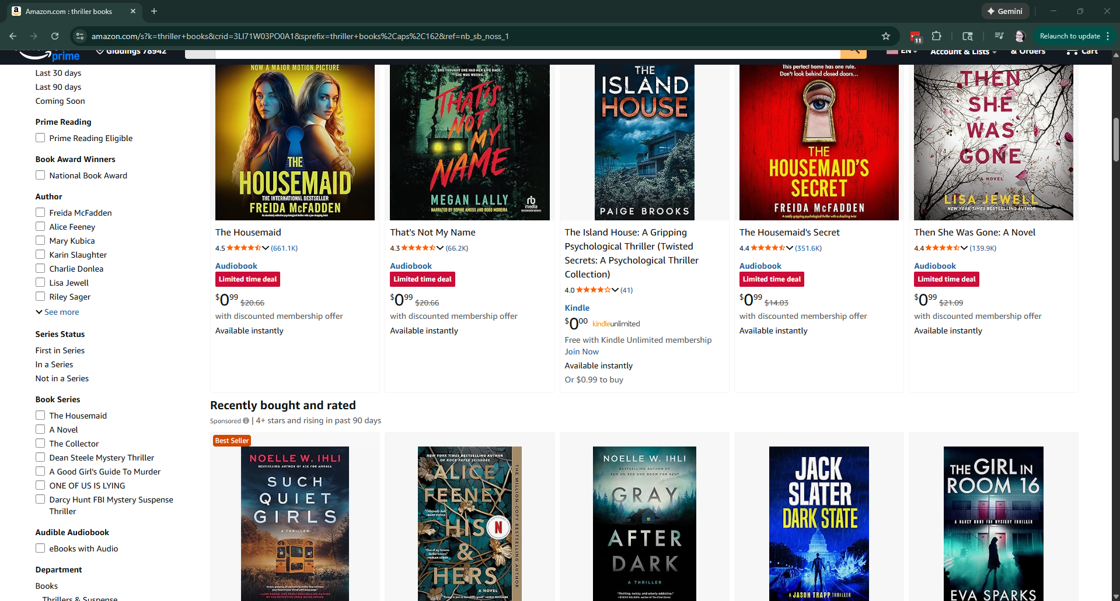
Notes:
This example: “Thriller Books.”
- bold colors
- dark feel
- Bold, big typography – no serifs

Slide 71
Your cover must
fit in enough
to communicate
the genre, but
stand out enough
to sell.
Notes:
There are a lot of subtle signs that cover designers specialize in communicating genre to audiences. This is why they are worth the cost.
But there are 2 main tools to help achieve this: COLOR THEORY and TYPOGRAPHY (font treatment).

Slide 72
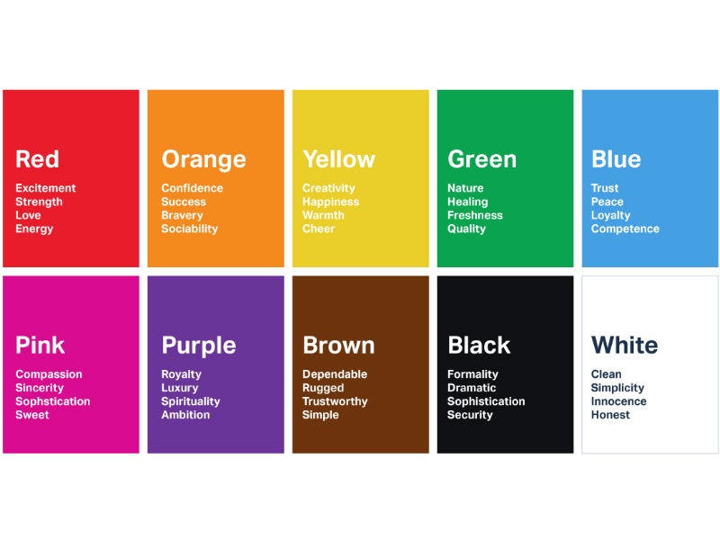
Notes:
Red: Danger, urgency, passion (Thrillers/Romance)
Yellow: Growth, positivity (Self-help)
Green: Nature, healing (Cozy Fantasy)
Blue & White: Trust, authority (Business/Non-fiction)
Brown: Historicals

Slide 73




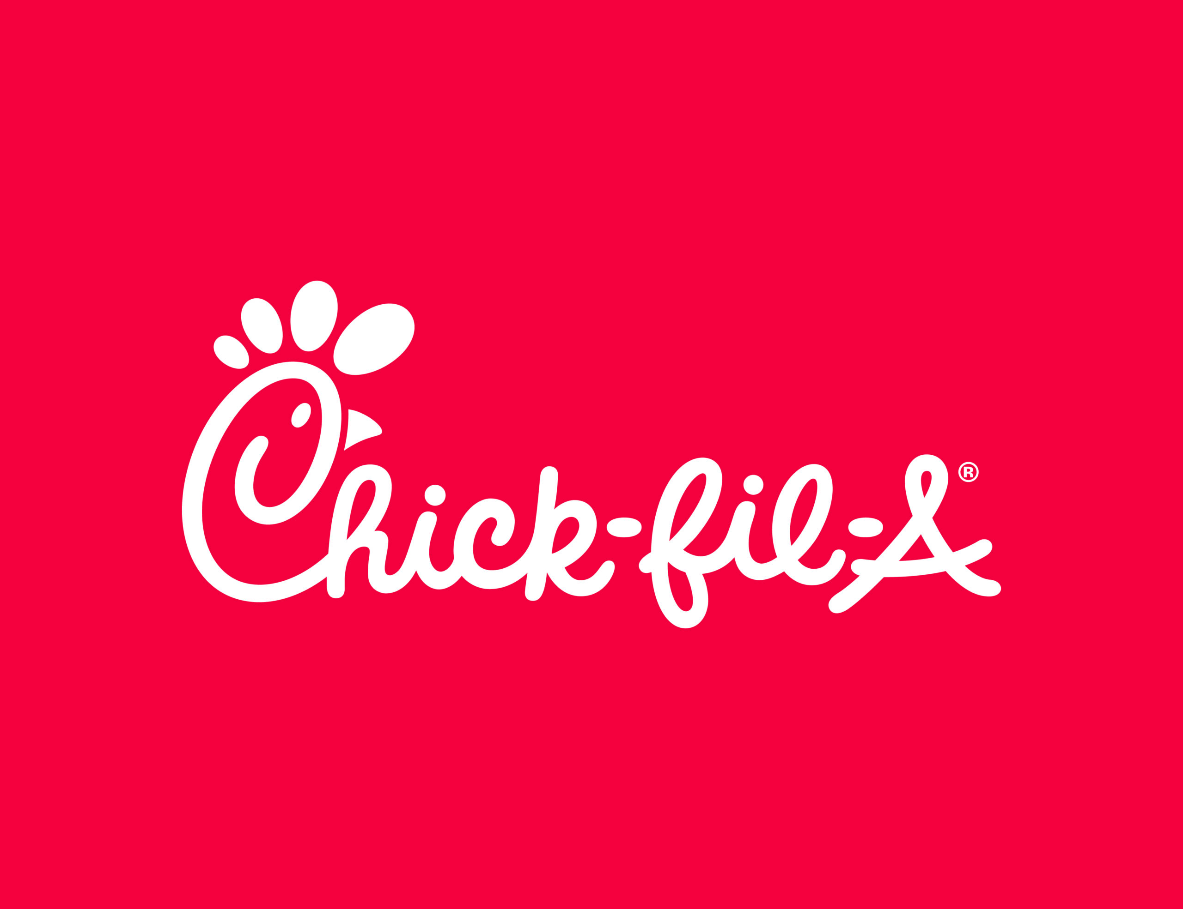

Notes:
Red & yellow are associated with hunger, passion, energy, excitement, happiness
Great for books that get your blood pumping, whether it’s danger or romance.

Slide 74
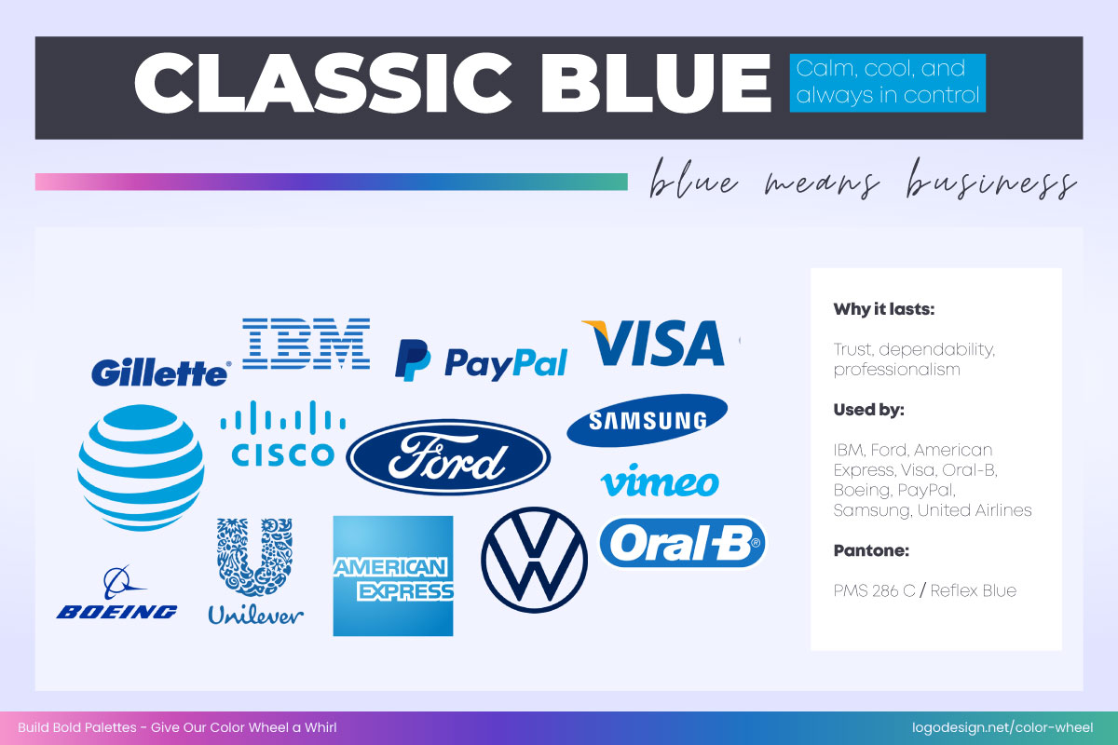
Notes:
Blue means business. Calm, cool, and always in control. Great for non-fiction.

Slide 75
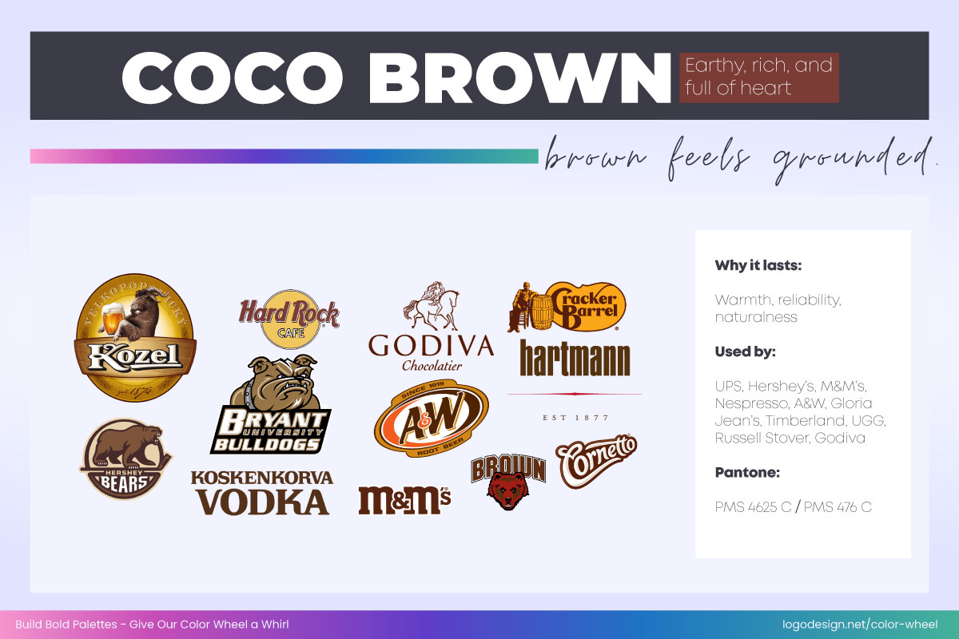
Notes:
Brown feels grounded. Earthy, rich, and full of heart.
Great for historical fiction and nonfiction going for a classic feel. Sepia tone.

Slide 76
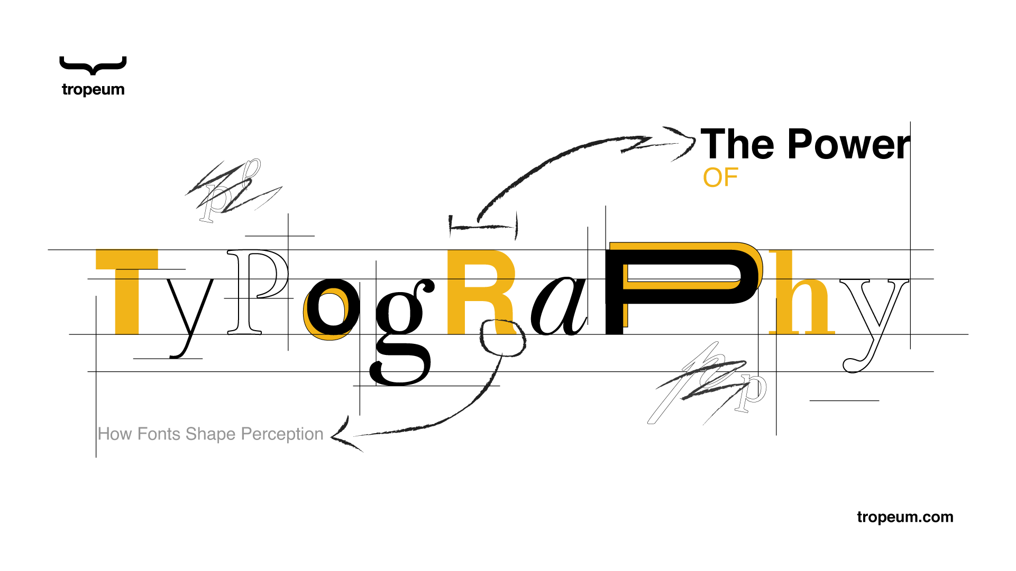

Slide 77
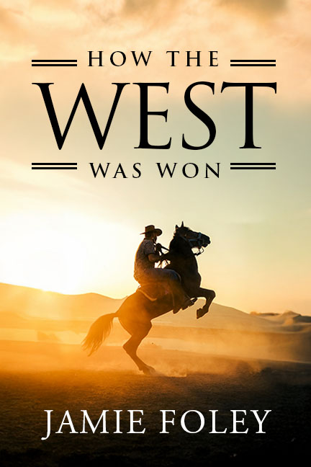

Slide 78


Slide 79


Slide 80

Notes:
In a world… after the ever…
If a horror book looks like a self-help guide, you haven't been creative; you've mismanaged your brand.

Slide 81
Genre mismatch kills
discoverability.
Notes:
If you’re not targeting the right genre, the algorithms won’t push it to the right audience, and the right audience won’t recognize it as something meant for them.

Slide 82

Notes:
“But Jamie!” you say. “What if I’ve already published my book and my cover sucks?”
Good news: if you have the rights to your book (if you’re an indie author), you can launch a special edition with a new fresh cover.
It will even be an excuse to market your books anew all over again. Inject new life into it, make more sales.

Slide 83


Notes:
Can you tell what genre it is?
Even though I have a degree in digital art, I was basically my friend’s nephew’s cousin in art school that I told you NOT to hire.
So I hired a professional. Kirk DouPonce from the video I played at the beginning. It’s a slight improvement, huh?
Good marketing just helps a bad product fail faster. So, let’s make sure we make a good product!

Slide 84
Save up.
Be patient.
make it awesome.
No Compromise.
Because The internet
never forgets.
Notes:
Don’t have the money to hire your favorite artist yet? Don’t have enough time for writing or editing?
Delay the publication date and save up. Don’t compromise or it will hurt you in the long run.
The internet never forgets and you don’t want to regret anything 10 years down the road. Your children will hand your book to great-grandchildren one day.

Slide 85
The secret
to a successful long-term writing career
is to focus on serving your readers
and striving to do everything
with excellence.
Notes:
Marketing isn’t about the sale of one book. It’s about your brand and the long term.
A career in writing means you will also want to sell your twelfth book, and your thirty-third book.
So be consistent with excellent design and protect your brand above all else.

Slide 87
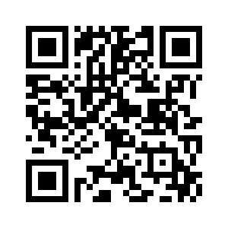
jamiefoley.com/events/book-design
Download this powerpoint at:

Slide 88

QR code and link

Slide 89
