Slide 1
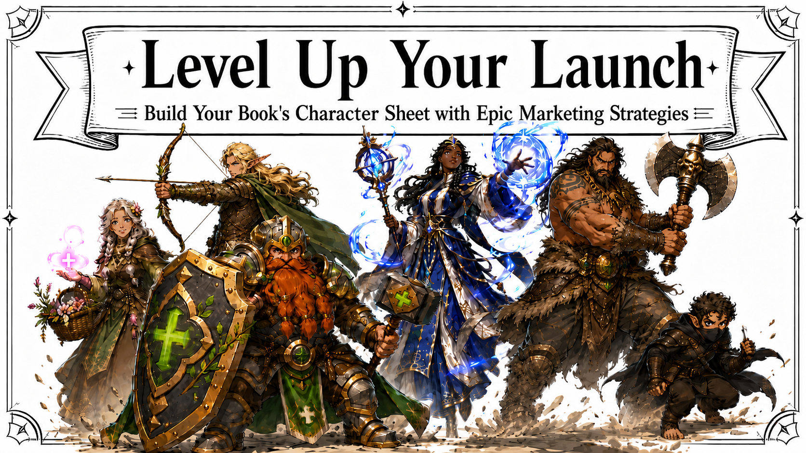
Notes:
How many of y’all have launched a book before?
Book marketing sometimes feels like a roleplaying game to me, or at least the inventory minigame. You start out thinking, ‘I’ll just carry a few useful things,’ and two hours later you’re carrying 17 wolf tails, 3 cursed daggers, a suspicious egg, 6 social media platforms, 72 sycophantic emails probably written by AI, 18 scams, and a tote bag full of bookmarks you paid too much to ship.
So today, we’re going to clean out all the stress from your bag of holding.

Slide 2
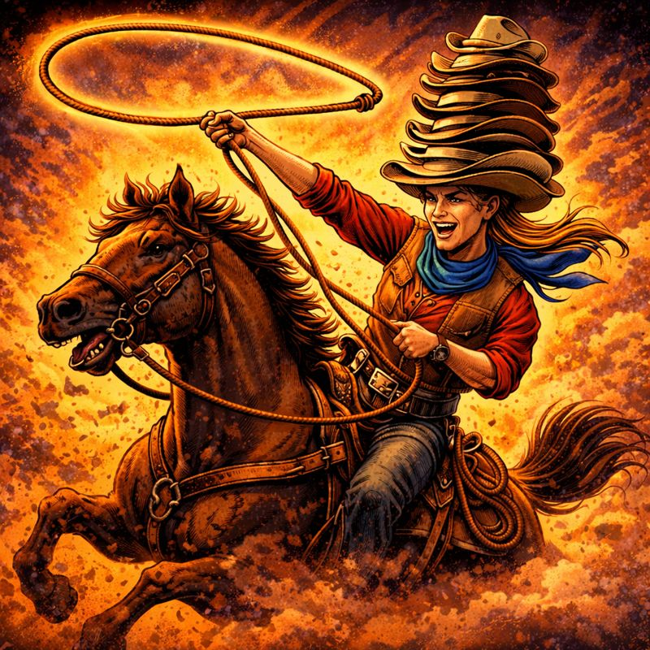

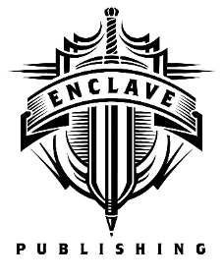
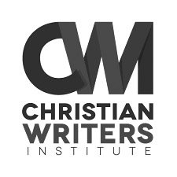
BY DAY, many hats
Marketing Director & Creative Director
Typesetter / Interior book designer
Consultant for authors
Notes:
Howdy! My name is Jamie Foley. I wear many hats, but my tallest hat is working as the Creative Director for Enclave Publishing and in the marketing department for Thomas Nelson/HarperCollins.
I also specialize in typesetting and interior book design, and I’ve also consulted for New York Times bestselling authors including Catherine Marshall’s Christy estate.
But . . .

Slide 3

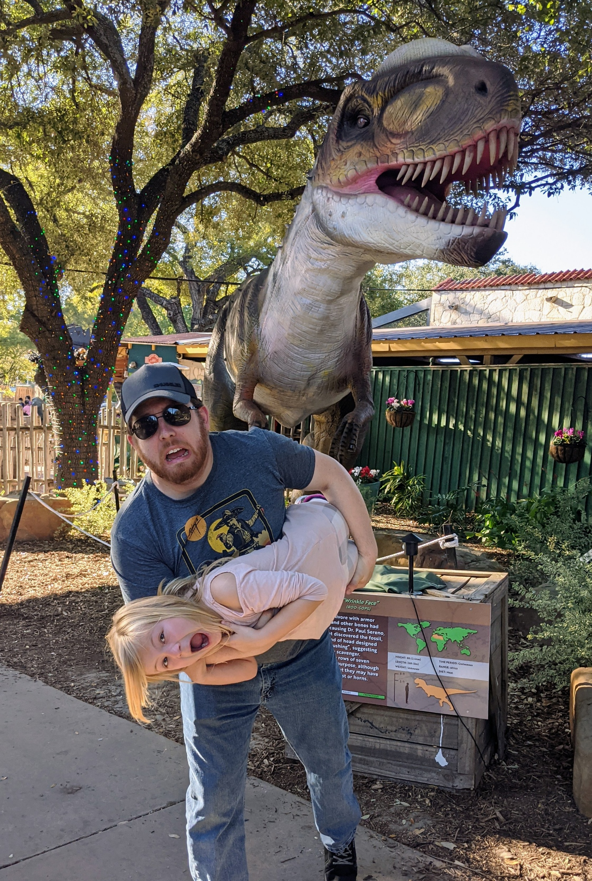
Notes:
I recently stepped down from my leadership role at Enclave to be a mom for my new baby. Here she is, and my oldest daughter and husband running from a dinosaur.
We live in a house where the floor is lava, every snack is the wrong snack, and silence means someone is either asleep or committing a felony.
I’m still recovering from pregnancy brain, so please be patient with me if I forget a word or make an absolute fool of myself. My brain still has open tabs from 2012.

Slide 4
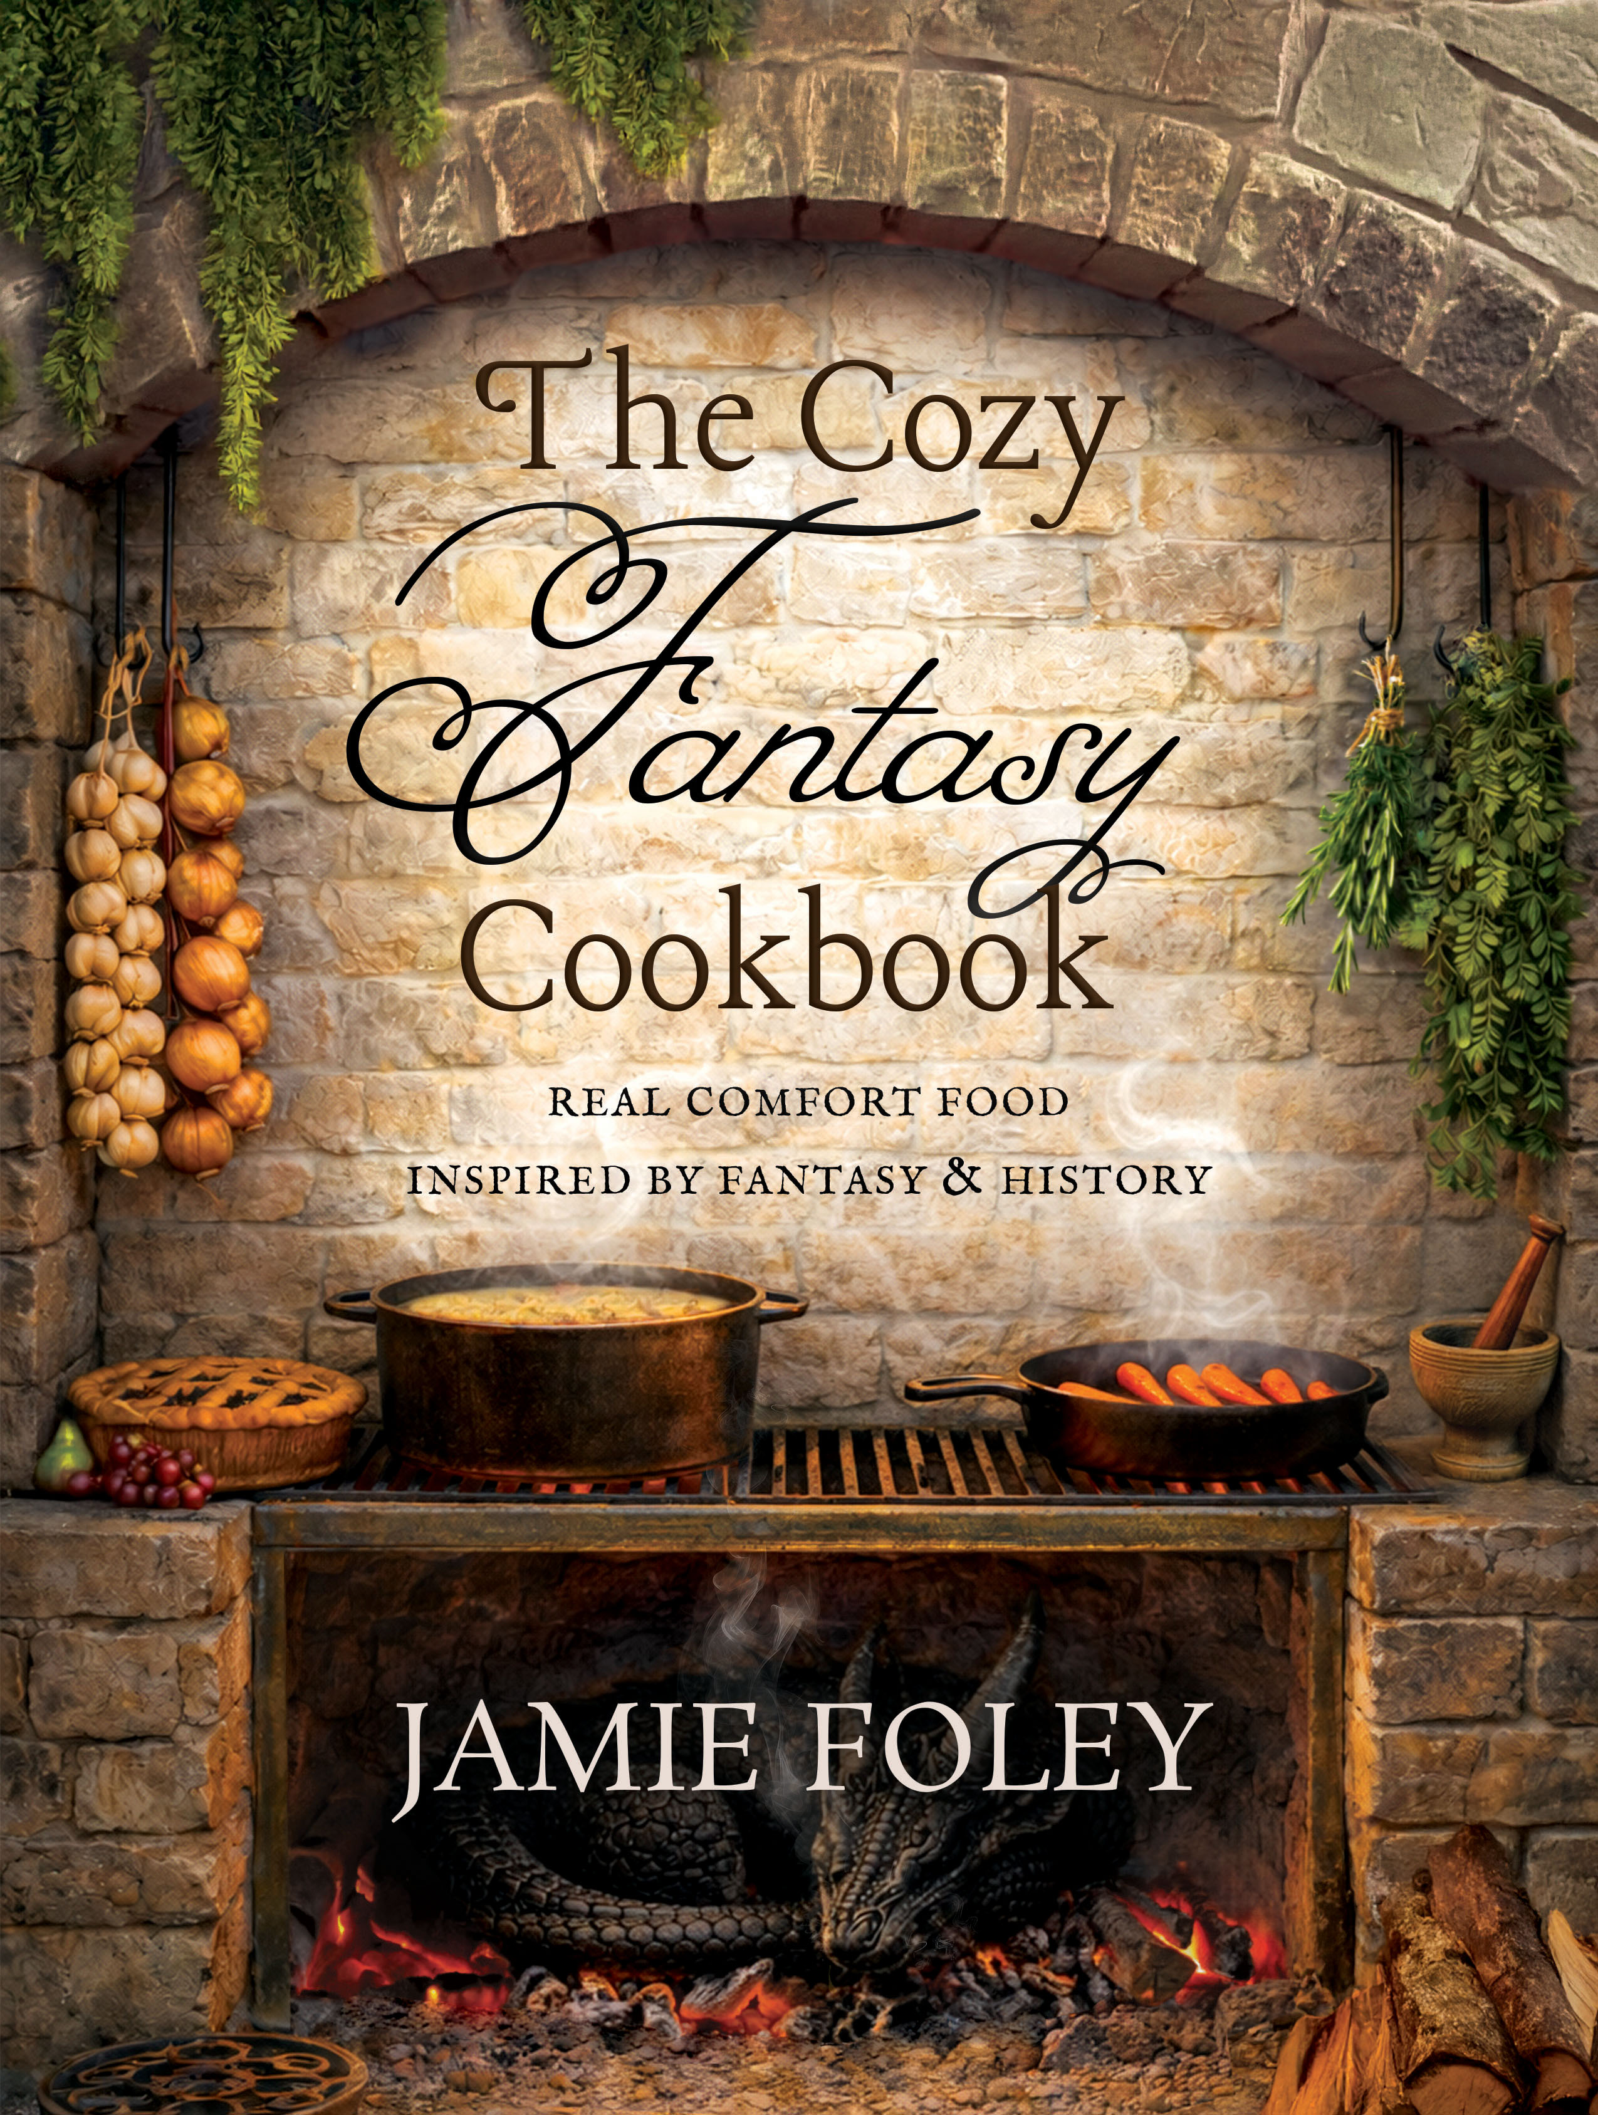
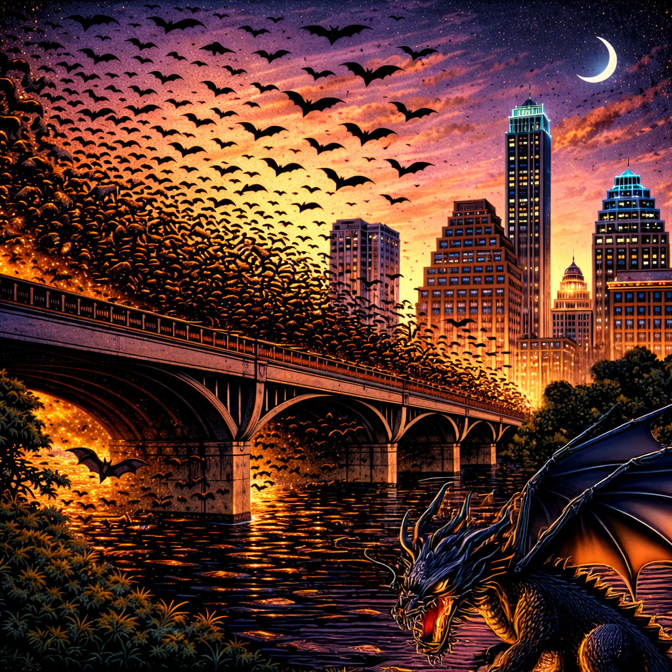
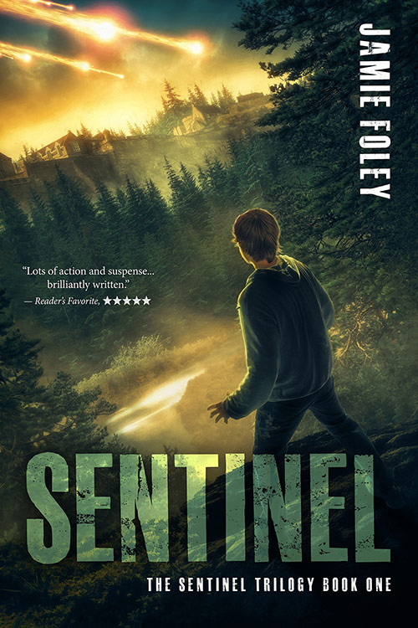

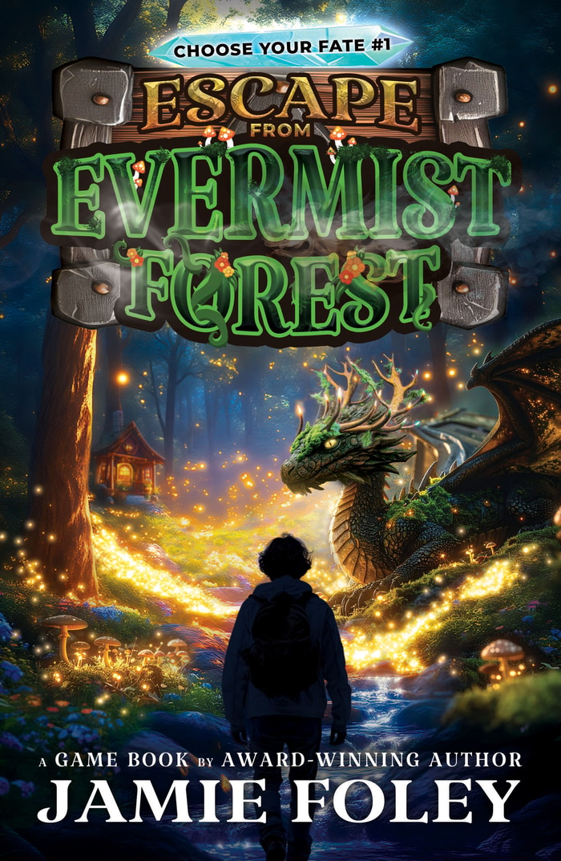
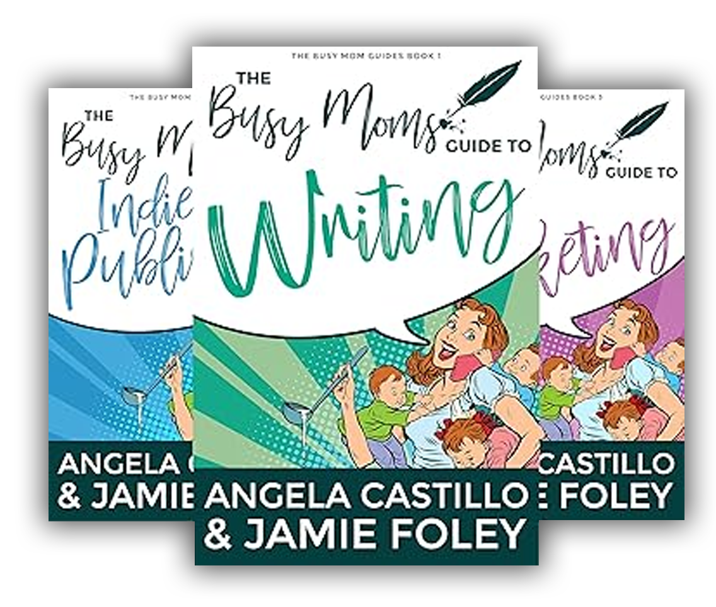

BY NIGHT, many bats
Award-winning sci-fi/fantasy author of 12 books
Non-fiction author of helpful books for authors:
The Busy Moms Guides series
Founder of Fayette Press
Notes:
By night, I’m an award-winning sci-fi/fantasy author of 12 independently published books, including the Sentinel Trilogy and the Katrosi Revolution series, and the non-fiction Busy Moms Guide to Writing series, which I wrote to help other authors with writing, publishing, and marketing.
I’m also the founder of Fayette Press, which is a brand for indie authors of clean sci-fi/fantasy books.

Slide 5
Notes:
Today we are talking about book launches.
Launching a book can be overwhelming, even for experienced authors. There are ads, newsletters, social media posts, cover reveals, preorder campaigns, launch teams, podcasts, book trailers, giveaways, swag, shipping, in-person parties, libraries, bookstores, schools, and that one person on the internet who insists you must be on whatever new social media platform launched yesterday or your career will perish into the bog of eternal obscurity.
And I am here to say: no. You do not need to do everything. No, you do not need to be everywhere.
No, you do not need to spend all of your money on every shiny marketing opportunity like a raccoon who found Red Bull and a credit card in the same dumpster.

Slide 6
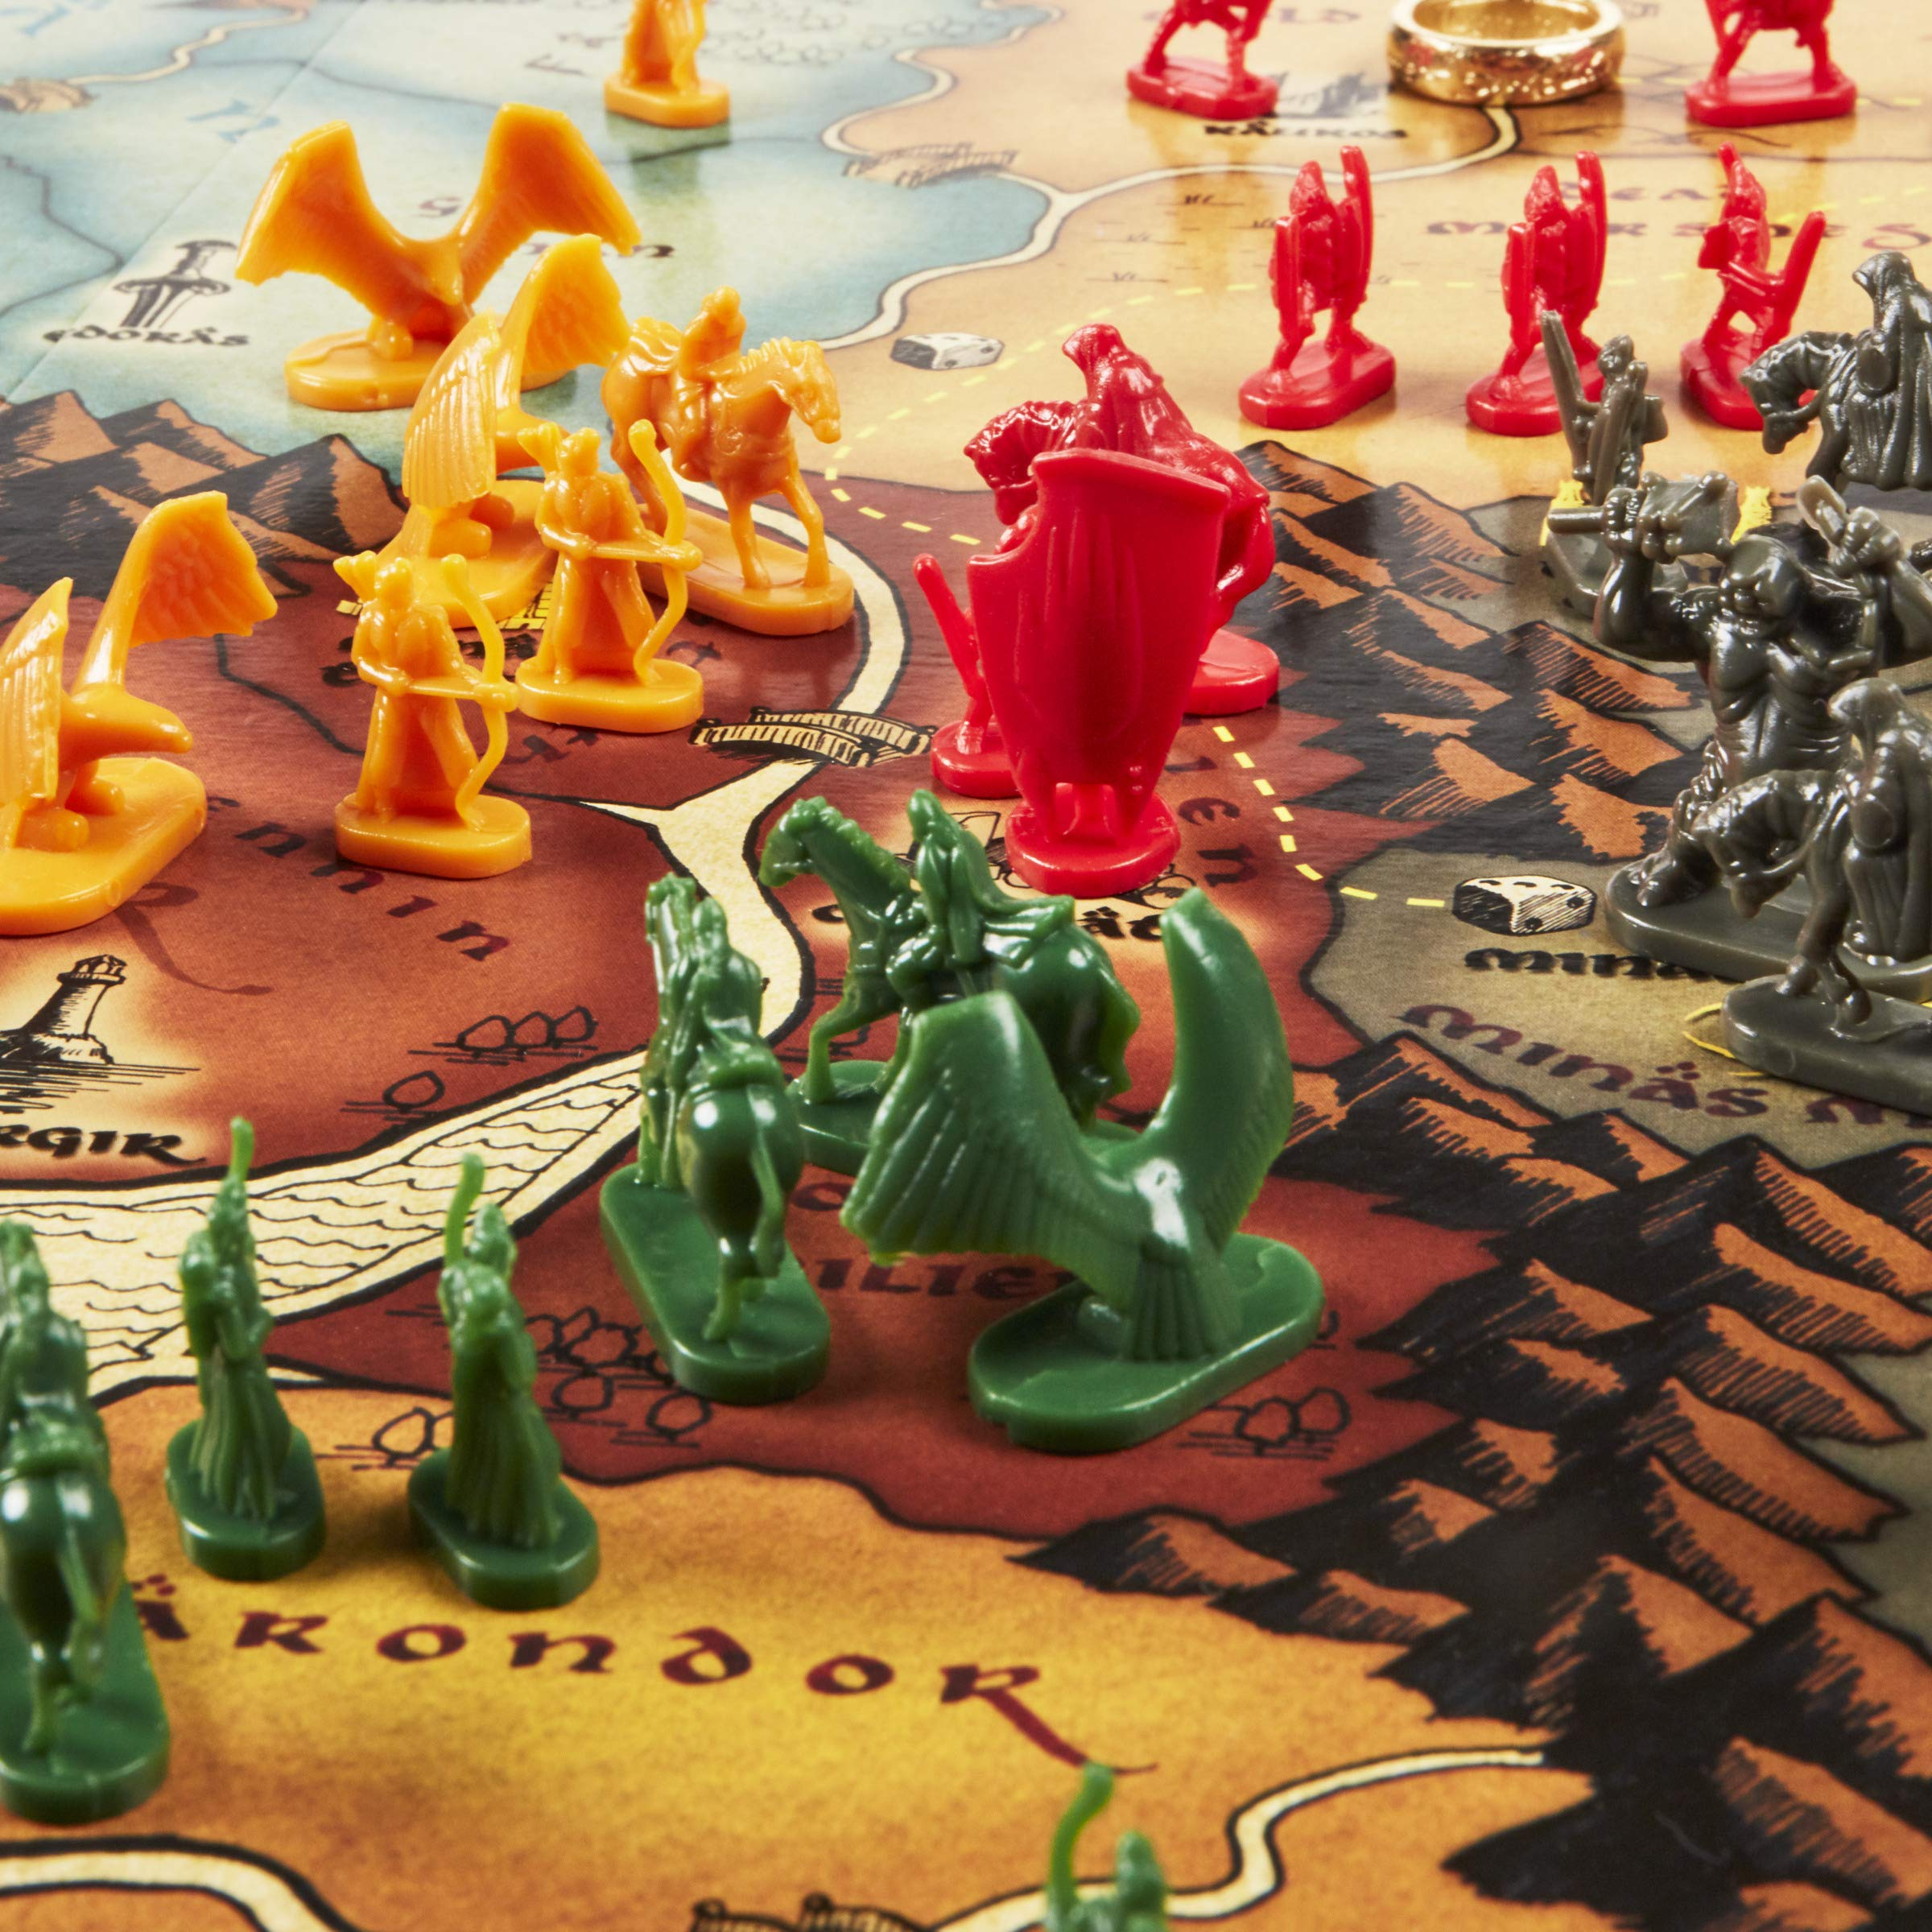
Notes:
What you need is a strategy to win Lord of the Rings Risk and get the ring to Mount Doom—without any help the eagles.
Yes, this is my favorite board game, and everyone in my family refuses to play it with me. I have no idea why.

Slide 7

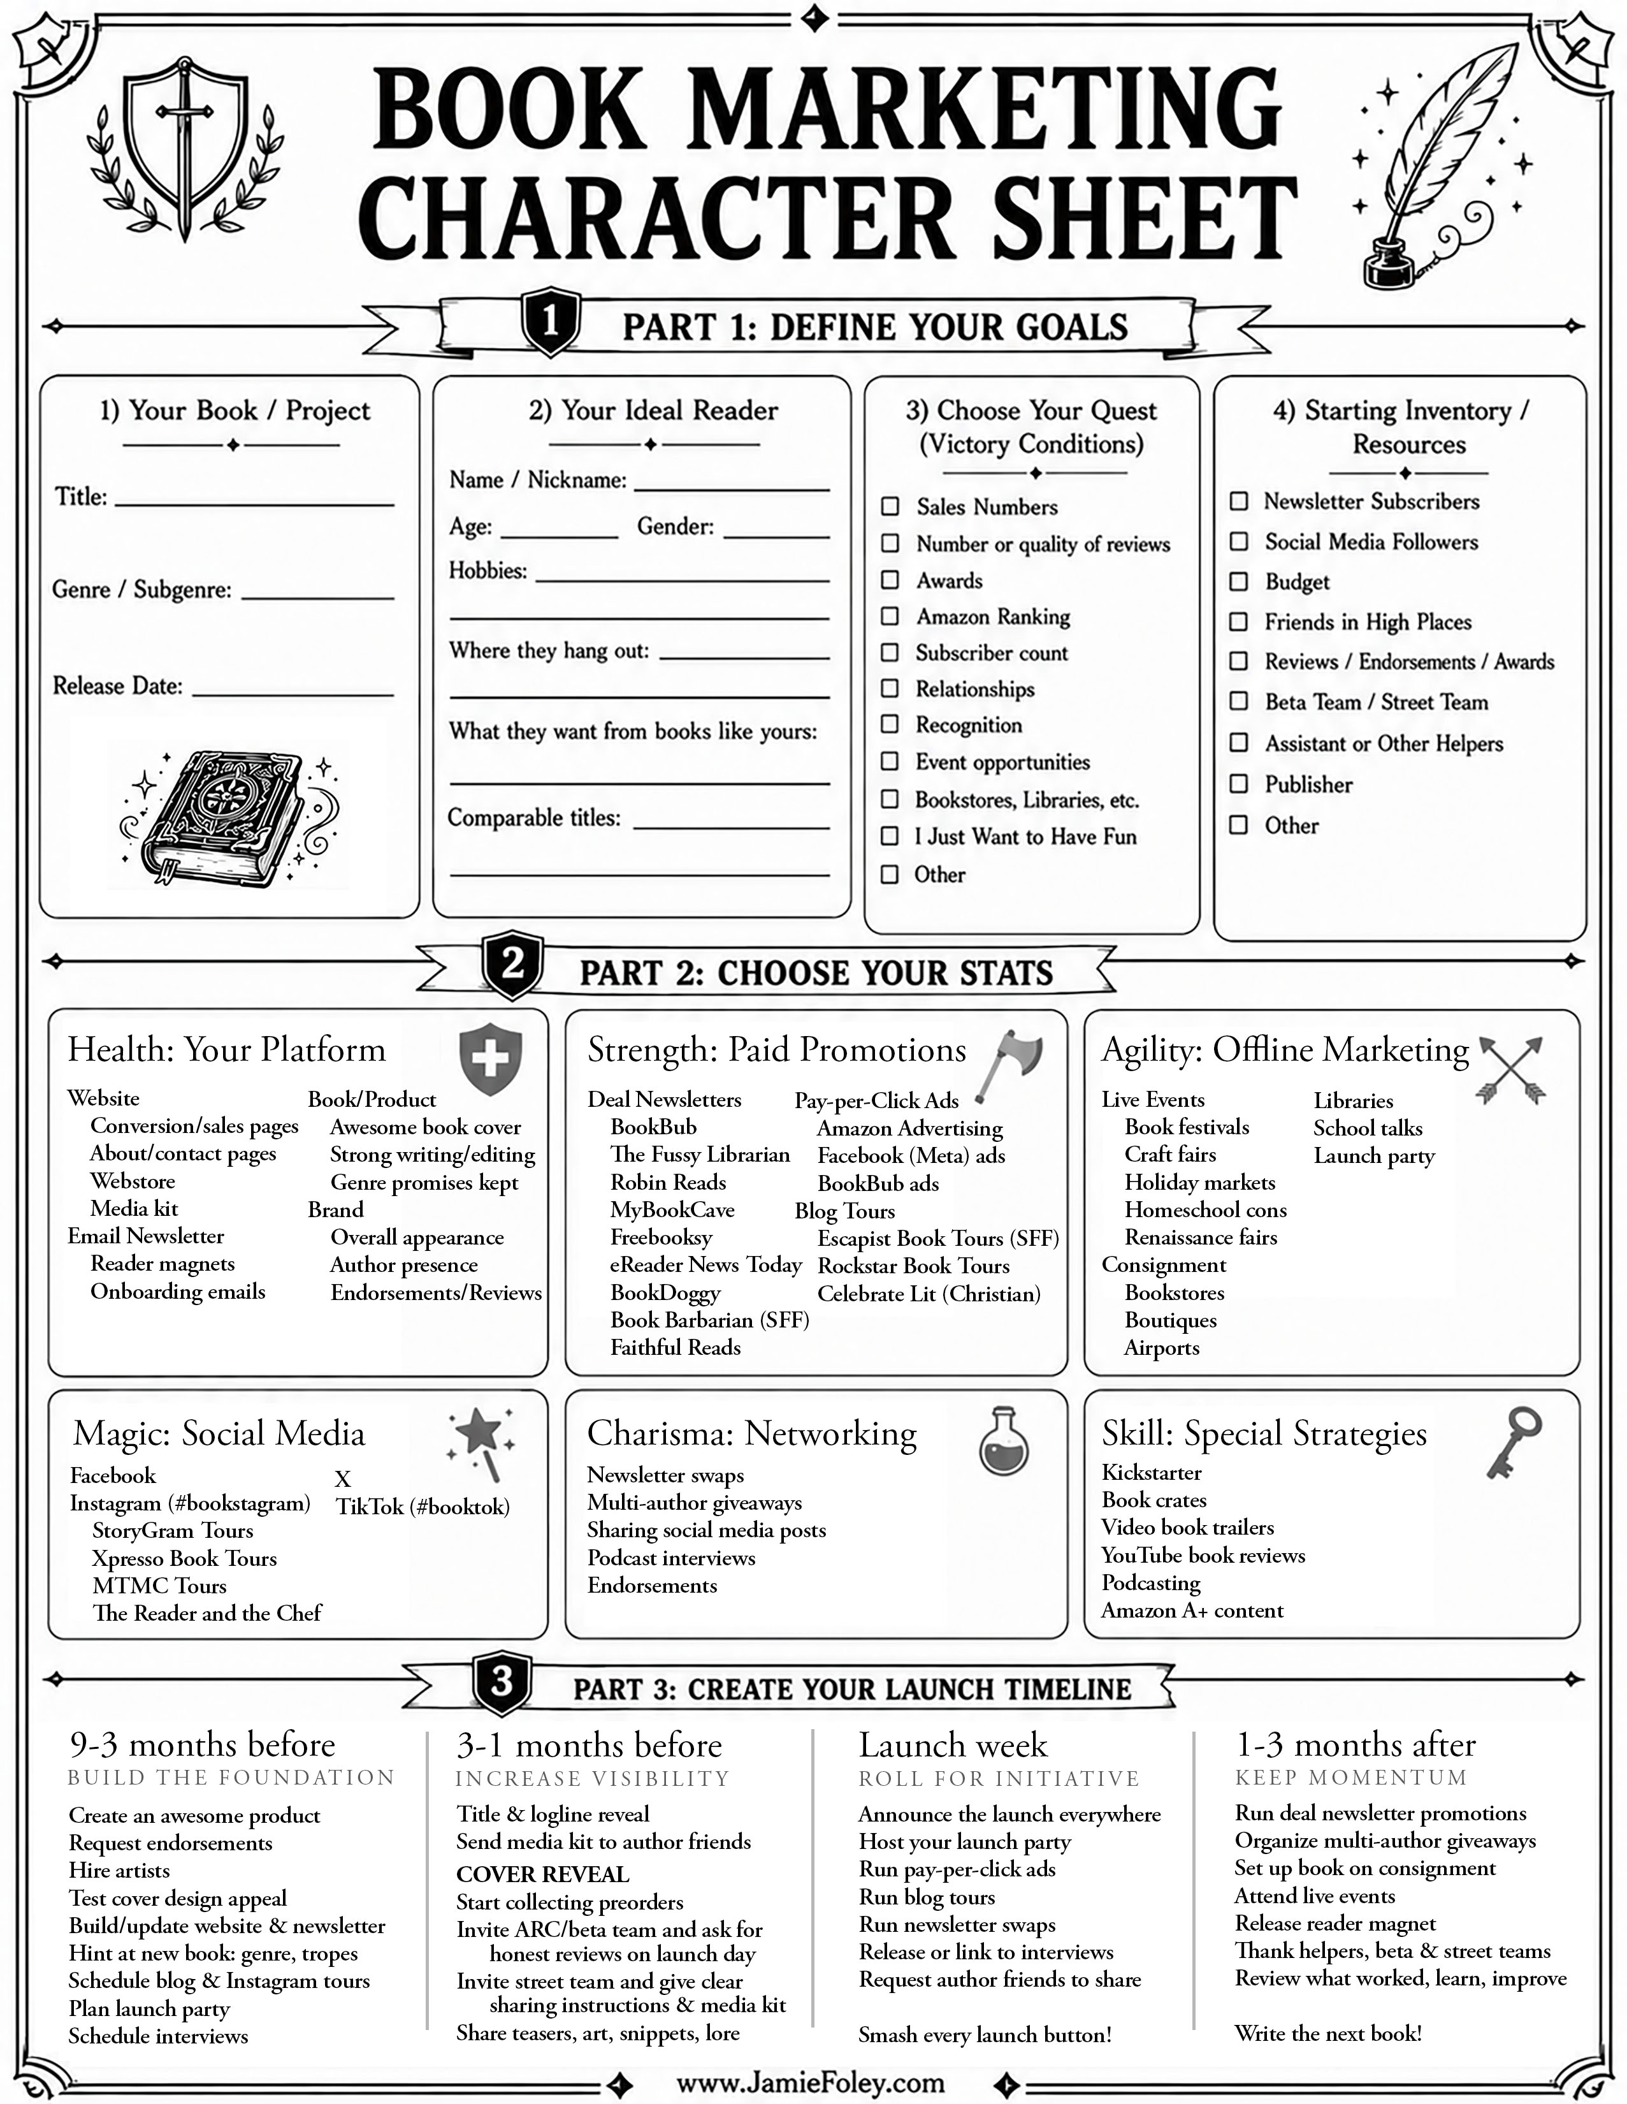
Notes:
So today, we are going to organize your book launch like a character sheet. We should have enough print outs here for everyone. Let’s hand these out, please.
I crammed them full of information so there’s not much room to take notes, but feel free to circle or underline things you are interested in and take notes on the back.
If you want more of these character sheets for your other books, at the end of this class, I’ll put up a slide with a QR code with a link to my website where you can download this document you can print out more for yourself.
On my website you can also download this PowerPoint presentation with everything I’ll say in this class. So if I talk too fast or you miss something, don’t worry.

Slide 8
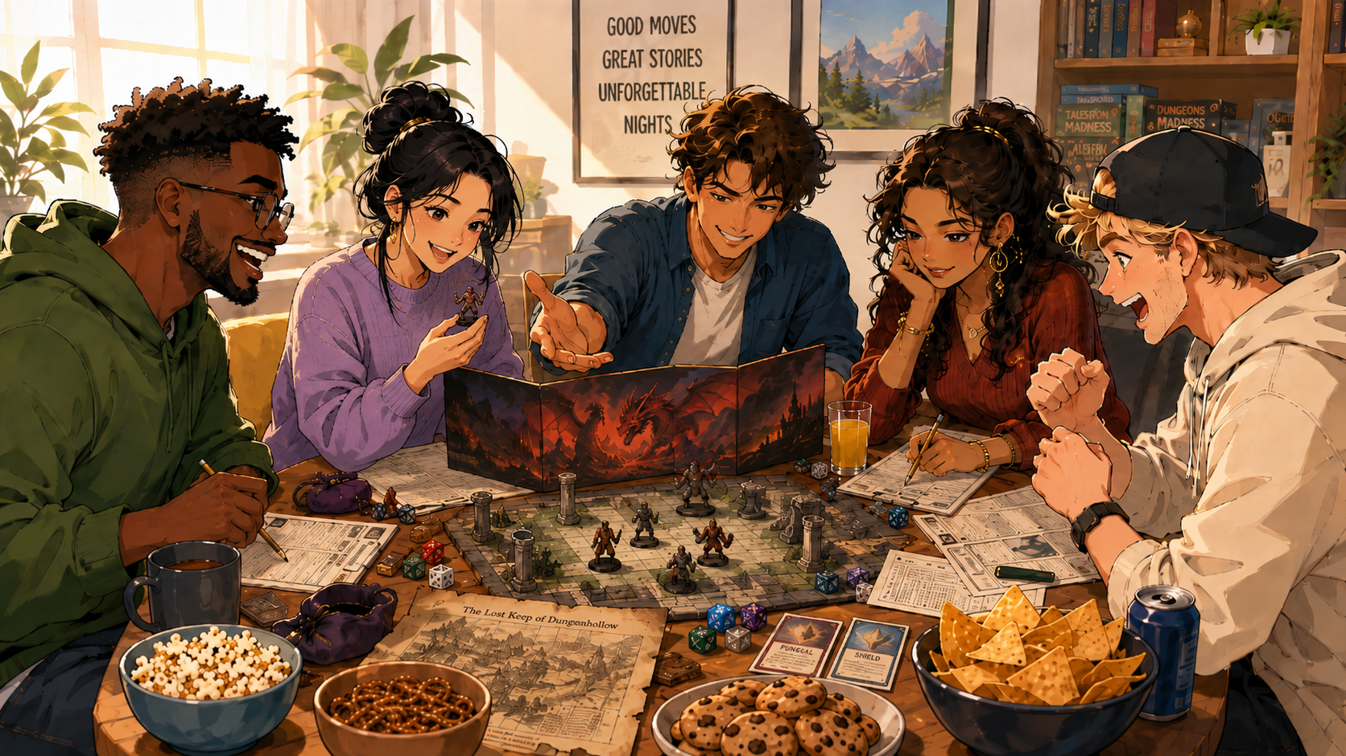
Notes:
Some of y’all are gamers. Some of y’all married gamers. Some of y’all gave birth to gamers. Some of y’all have no idea what I’m talking about, but you decided to attend this conference filled with lightsabers and dragons, so you knew what you were getting into.
In a roleplaying game, your character cannot be good at everything. You can try, but then you end up being mediocre at everything and useful at nothing. You have to choose your strengths.
Maybe you build a mighty barbarian character with ridiculous strength who solves every problem by hitting it with an axe.
Maybe you build a sneaky rogue who avoids the problem, steals the key, and is already eating snacks in the next room while everyone else is still arguing.
Maybe you build a wizard with terrible physical abilities, but the ability to melt everyone’s eyebrows off or conjure frosty strawberry mochi ice cream.
Marketing works the same way.
You have limited time, limited money, limited emotional energy, and presumably, you still need to write the next book.
So the goal of this class is not to make you feel guilty about all the marketing you are NOT doing.
The goal is to help you decide which marketing strategies fit you, your book, your genre, your audience, your budget, and your season of life.
By the end of this class, you should have the beginning of a custom launch plan instead of an inventory full of stress.

Slide 9
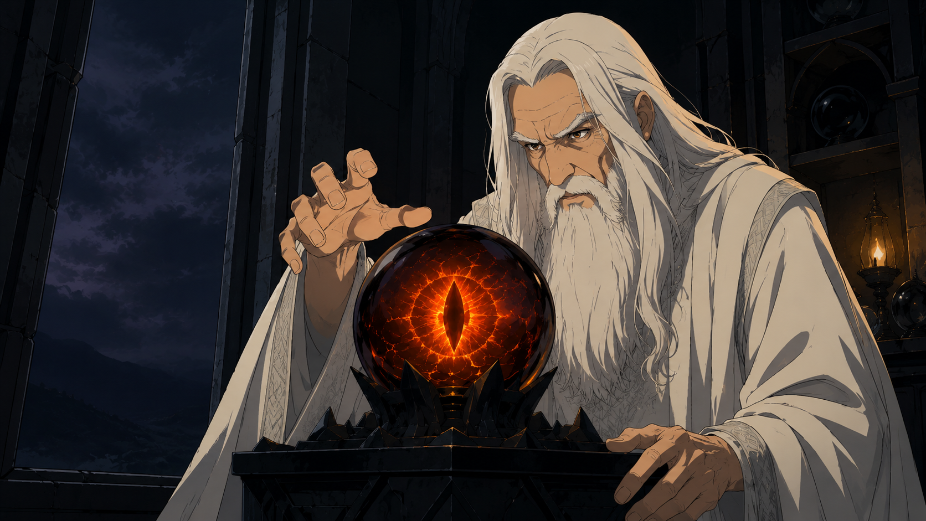
Notes:
Now, before we begin, I need to give a warning.
I do not own a crystal ball. I do not own a Palantir. I do not have a prophetic marketing ferret who whispers the secrets of the algorithm into my ear.
Marketing always involves risk. You could follow everything I say today and your book could still underperform for reasons outside your control. The market might shift. Your genre might be difficult. Your book cover might miss the target. Your timing might be bad. Your publisher might change plans. Amazon might wake up one morning and choose violence.
Marketing is always a gamble.
I am not here to hand you a pair of weighted dice. I am here to give you a bonus to your luck score.

Slide 10
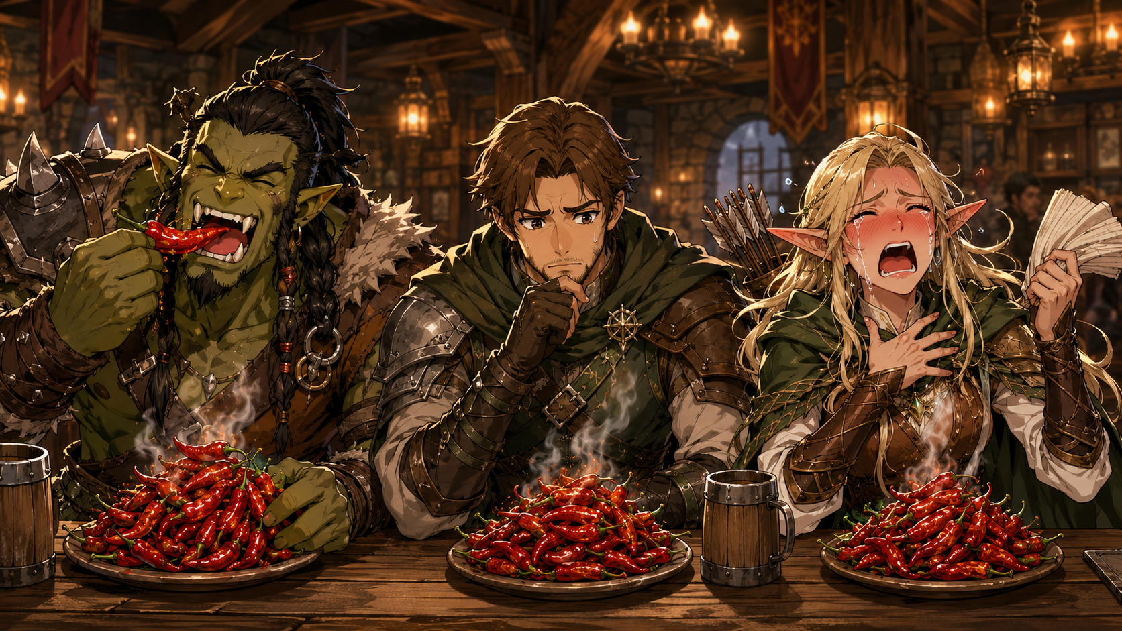
Notes:
Second warning: some of what I say might sound… spicy.
I am not trying to shame anyone. I am trying to help you sell books. To real people. In the real marketplace.
We are writers, creatives, and dreamers. Some of us would prefer to live in Narnia and communicate exclusively handwritten letters sealed with wax and meaningful stares from the dark corners of taverns.
But unfortunately, we are selling products in a very real, competitive marketplace. So we need to be grounded in reality, even if harsh. Maybe just on Tuesdays, though.
Does that make sense? Are we all on board?

Slide 11
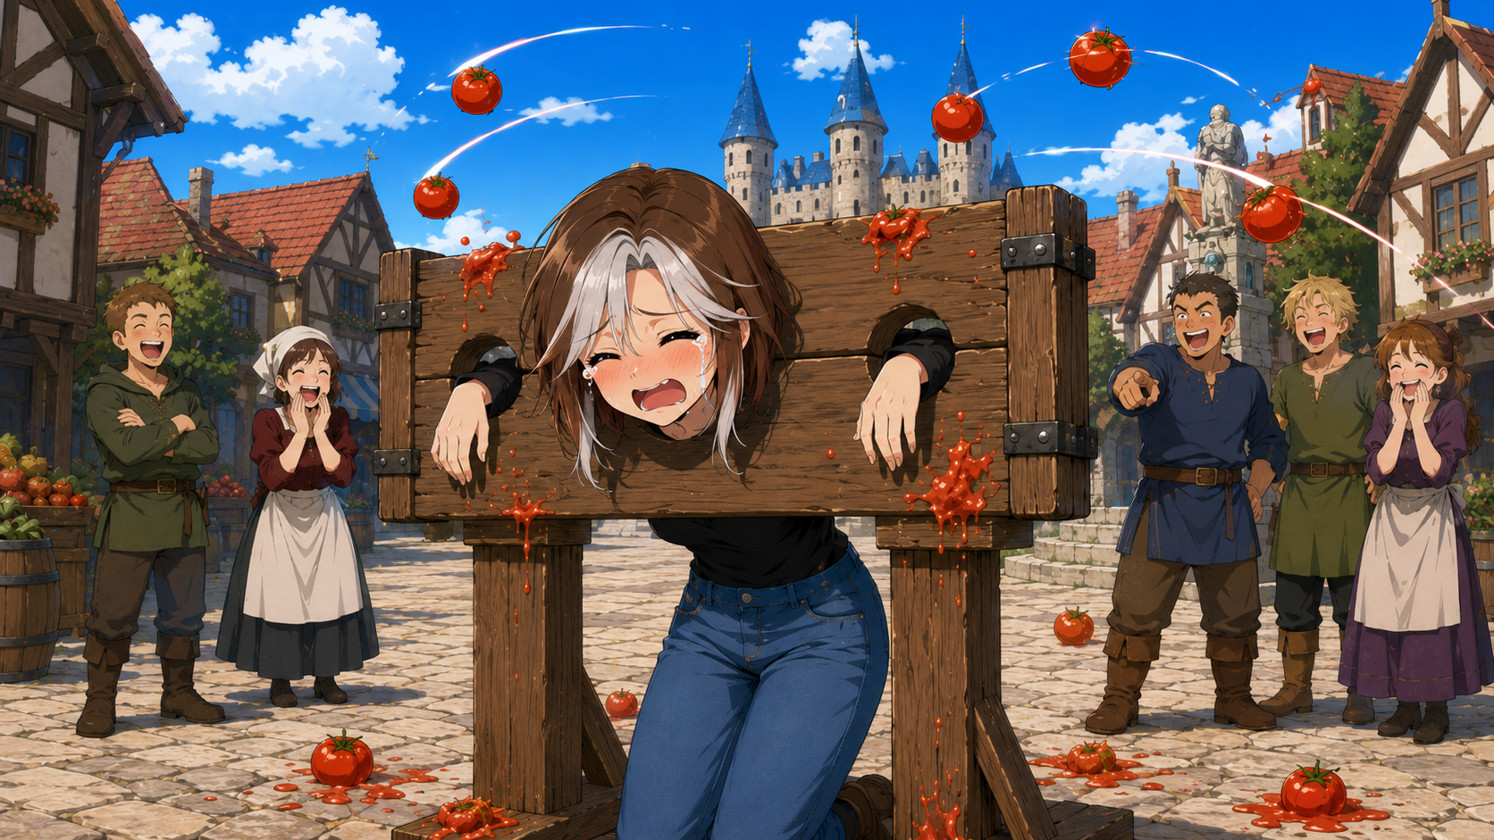
Notes:
Excellent. If you hate the class, you can throw tomatoes at me at the end.
This class has three parts.
In Part One, we will define your goals. In Part Two, we will select your stats and which marketing strategies are right for you and your book. And in Part Three, we will create your launch timeline.
So let’s begin.

Slide 12

P a r t 1
DeFINe YouR GoAls
Part 1:
Define Your Goals
Notes:
Before you choose your marketing tactics, we need to define your goals. First, let’s identify your ideal reader, which is your target audience.
Because if you don’t know who you are trying to reach, every marketing decision becomes a miniature panic attack.
Should I be on TikTok? Should I run Facebook ads? Should I buy a billboard? Should I hire a town crier? Should I release a carrier pigeon?
If you don’t know what to aim at, your arrow is sure to miss the mark.
Some of you may be thinking, well, I wrote my book for . . . me. And that’s fine--when I started out, my target reader was a younger version of myself: a girl who wanted more adventure and dragons than bonnets and romance.

Slide 13

Notes:
But, if you’re writing for yourself, that mindset is closer to a hobby writer than a professional author.
If you’re writing to please yourself, you can do that without even publishing the book. So why do all this work and investment when you already have what you want? Why listen to an editor who tells you to do something different than what you want to do?
And listen, hobby writing is not bad. If you want to write stories for your own enjoyment, that is a perfectly valid and wonderful thing to do. You can write whatever you want. You can write a 400,000-word literary novel about a lonely spoon. You can make every character a mushroom. Why not?
But if you are asking people to pay money for your book, then your book is a product. And products are created to serve their buyers.
That does not mean you betray your artistic soul. It means you discipline your art so it can reach and delight the people it is meant to reach.
Some of you may say, “My book is for everyone.” Well, I have bad news.

Slide 14
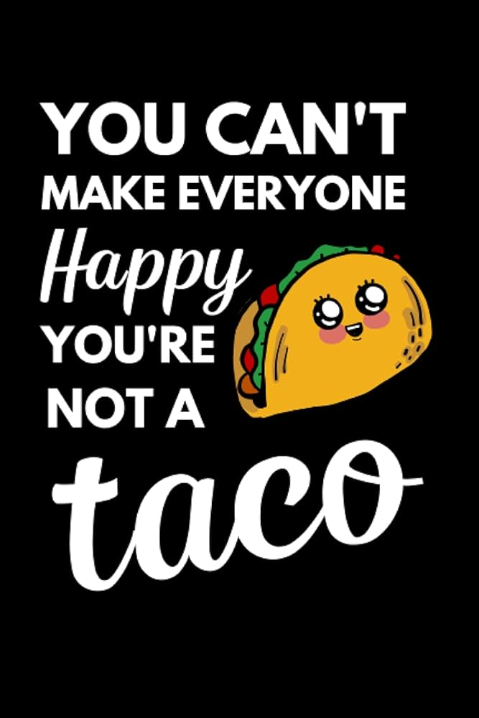
Notes:
You can’t make everyone happy. You’re not a taco. And neither is your book.
No book can actually be for everyone. Except the Bible. And even though Jesus is chillin’ in my heart, my YA science fantasy urban apocalypse dystopian series is NOT the inspired Word of God.
Unfortunately it is impossible for you or your book to please every single person on this planet. Fans of historical naval fiction might be older men who enjoy fishing and pipe smoke, while your young adult werewolf adventure story with sparkly moon powers simply isn’t his cup of tea. And the teenage girl who loves cottagecore, Funko Pops, and emotional damage might LOVE your werewolf story, but have zero interest in your friend’s Amish romance.
Now, people are complicated. I’m not suggesting we shove people into tiny boxes.
But the point of this exercise is to create a stereotype in your mind that you can cater your writing and your marketing to. A target to aim at.
You need to imagine the reader who is most likely to love this book. Not tolerate it. Not maybe read it someday. LOVE IT.
Tell their friends about it. Post about it online. Show up at your table a year later asking when the next book comes out.
That is your ideal reader.

Slide 15

Notes:
So, on your character sheet, let’s start with your ideal reader.
How old are they? Are they male or female?
What are their hobbies?
Where do they hang out? Church youth group? The local bar? Homeschool conventions? The fishing pond? Facebook? World of Warcraft?
What emotional experience do they want from books like yours? Do they want comfort? Adventure? Romance? Laughs? The thrill of solving a mystery? Do they crave justice?
What other books do they read? These are your comparable or “comp” titles. They are clues to tell you what your audience expects. They are your competition, and also they contain the promises you must make and keep to your readers in order to please them.

Slide 16
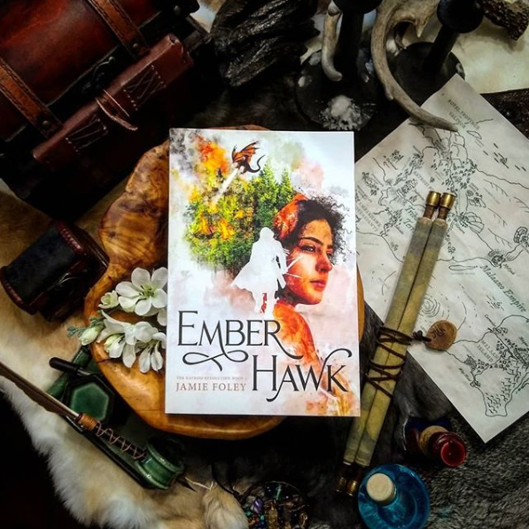
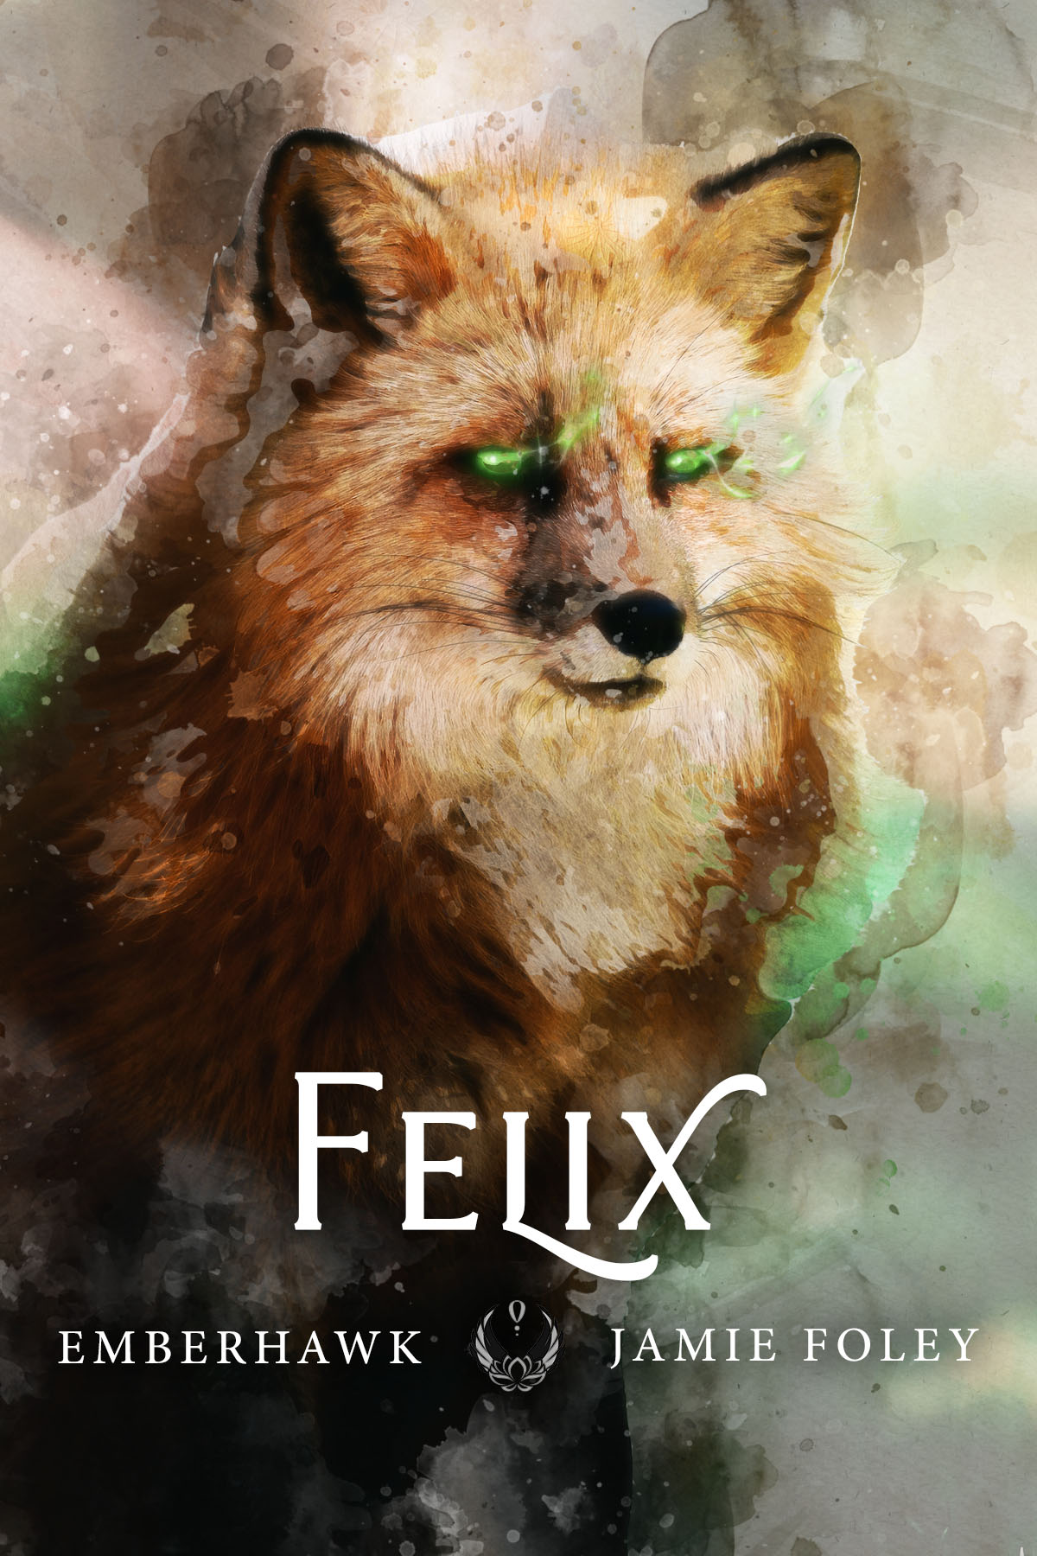
Notes:
Here’s an example. This is my ideal reader for my Emberhawk series.
Her name is Megan. She’s twenty-six, tired from her job, and longing to meet her future husband. She drinks exotic herbal teas and is working on her cooking skills. She loves clean romantasy, and wants a book that gives her banter, danger, yearning, a gorgeous map, and absolutely no sad dog deaths.
Or how about Greg (who would NOT like Emberhawk): He’s fifty-eight, loves military sci-fi, reads on Kindle, does not care about sprayed edges, and wants competence, strategy, loyalty, and spaceships that make sense.

Slide 17
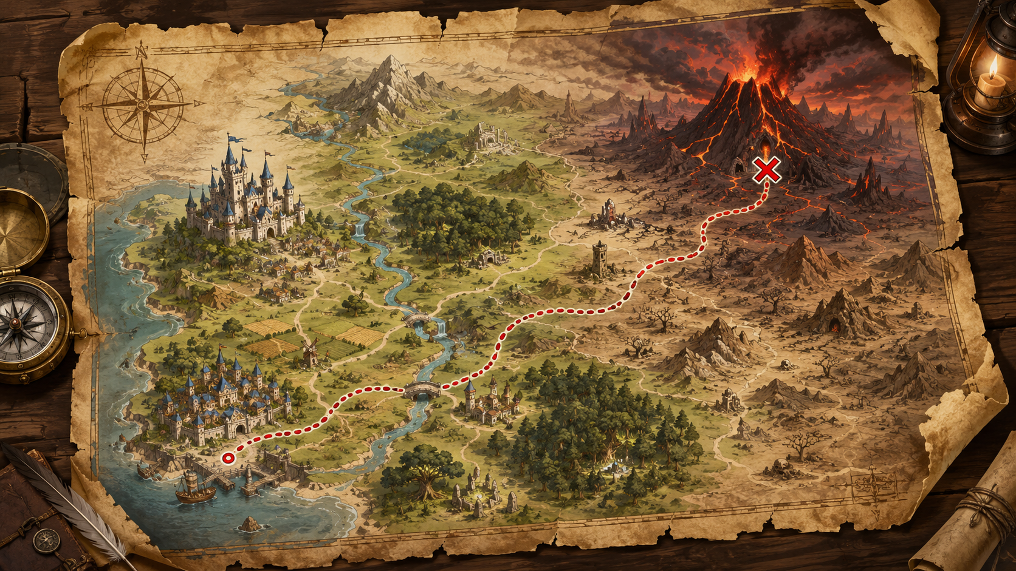
Notes:
Now that we know who we’re trying to reach, we need to choose our quest!
Before we set out, we should choose our destination and victory conditions. What does winning look like?
Does it mean sales numbers? Review quality, or total number of reviews? Awards? Your book’s Amazon ranking? Subscribers to your newsletter or social media? What about relationships with your readers or to other authors? Or are you craving recognition, or an invitation to speak or teach at a certain event? Maybe you really want to have your book for sale in local bookstores so you can cruise around in your D’Lorian every month and pick up consignment checks.
Once I finished a book within a certain timeframe just so I would have a new book to submit to an annual festival I wanted to attend. You might want to get a book done once per year so you can always submit for an award every year.
Sometimes your goal might be simple: I want to release this book professionally, serve the readers I already have, and not lose my mind. And that’s fine. Only you can define what success looks like for you with each book you publish.
As long as you DEFINE your victory conditions, and you select only 1-3 goals, you will have something to acknowledge and celebrate when you get there.
If your goal list looks like a CVS receipt, you do not have a strategy. You have a cry for help.

Slide 18
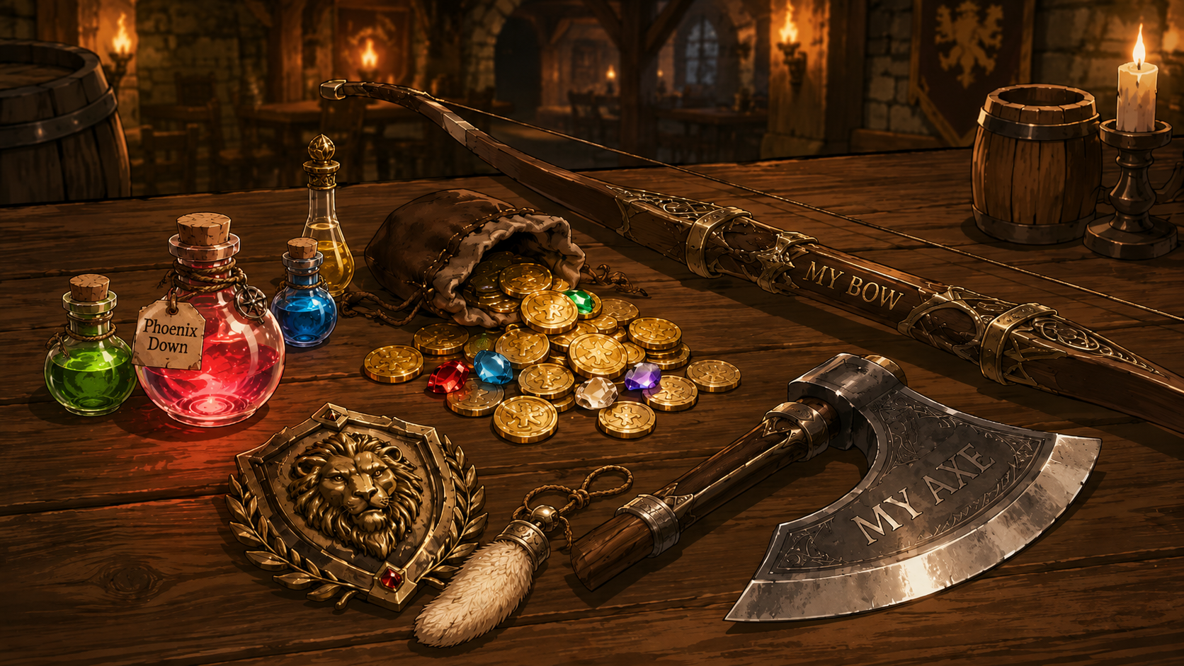
Notes:
Now, let’s identify what resources you already have to work with that will aid you in your quest. What tools are already in your inventory?
Do you already have an email newsletter with subscribers, or social media followers? Do you have a bulging coinpurse to allow for a large budget? How about author friends or helpful connections? Do you have reviews, endorsements, or awards that you can pull quotes or shiny badges from to advertise your next book? Do you have other friends or companions to help you along the way? Perhaps you have younglings for child labor. The children yearn for the mines. And occasionally stuffing bookmarks into envelopes in exchange for Turkish Delight.
Now, for the oliphant in the room. By show of hands, who in this room is independently published? Traditionally published? Or both--any hybrid half-elves?
There is no shame in either direction. I work for publishers, but my own books are indie so I can control every. Single. Detail.
But if you’re traditionally published, your publisher CAN control every single detail, so make sure to communicate with them about what marketing options you can do without stepping on each other’s toes.
Ask your publisher what marketing efforts they will do on your behalf, and get those specific commitments in writing. A publisher is a business partner. You succeed or fail together.
And if you want to be traditionally published one day, consider your future publisher based on what they can do for you. They may have an entire marketing department and a huge budget working on your behalf, or they may leave that entirely up to you.

Slide 19
P a r t 2
cHoOse YouR StAts
Part 1:
Define Your Goals
Notes:
It’s time for part two: our options for marketing strategy.
There are so many types of book marketing that it can be overwhelming, so I’ve organized different promotions into different “stats” for you to choose from.
Most people don’t have the resources to do all of these, unless you have a large team and a huge budget. Everything will cost either money or time and effort. And we need to balance our own energy because we should also be writing the next book.
The authors who try to do every single marketing opportunity don’t do any of them as well as they should be done, and they end up burning out.
So let’s select the few that work for you and your book specifically. You can try out more over time or with different titles.
That being said, this first one is what I think EVERY author should have, and it should be set up before anything else is done.

Slide 20
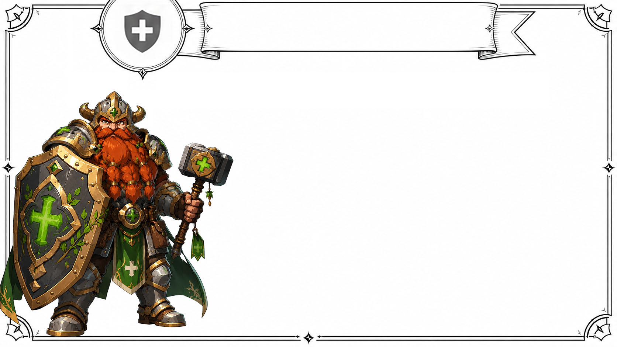
Part 2: choose your stats
health:
YouR
PlAtfOrm
Notes:
First is your own platform, which is like your health, or as some game systems call it, the Constitution stat. The character that has a high constitution is the “tank” of your party with an enormous shield to protect everyone else. He’s a reliable, unmoving, faithful foundation.
Without health, you can’t do anything. You can’t even sit back at camp and make pottage. You’re dead. Game over.
Your platform is the foundation that keeps your author career alive and growing with slow but steady growth.
It is everything that is a part of your brand, including your website, your email newsletter, and your books themselves. And most importantly, your book covers and the quality of everything inside your books that defines your writing voice and style. It even includes data about your book that you learn and refine over time to increase your sales, like your book’s metadata, which includes its keywords, categories, and SEO.
And this is everything else you own and control, like the onboarding sequence for your newsletter, your reader magnets, and the back matter in your books that point readers to your other books and ask for honest reviews or the reader magnet to foster newsletter sign-ups.
You might be wondering why this doesn’t include social media. That’s because you don’t have any control over social media. Sometimes not even your own followers get notified about your posts unless you pay. They can change overnight, accounts can be hacked or banned, and algorithms can decide you no longer exist.

Slide 21
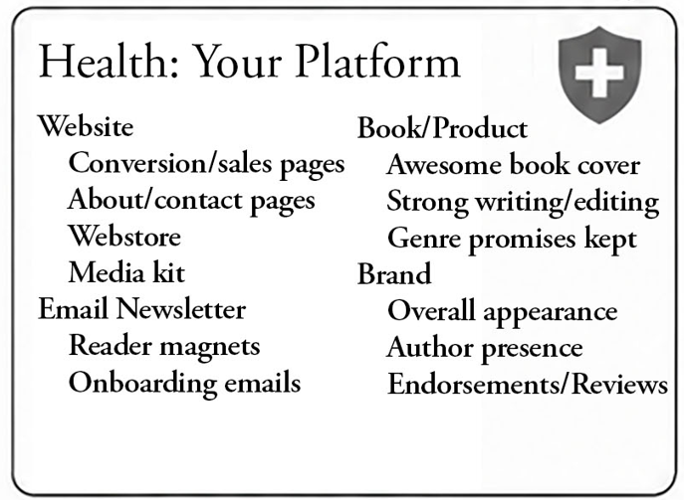
Part 2: choose your stats
Notes:
But your email newsletter is totally under your control, as is your website, which is your home base. Every author website needs to clearly communicate who the author is, what they write, and how to contact them author. And every book needs its own page designed to convert visitors into buyers. And ideally, a webstore where people can buy your signed copies, pre-orders, special editions, or swag packs directly from you.
A media kit is simply a download from your website with the assets people need to promote or interview you. Include your book cover images and synopsis, author photo, your short bio and long bio, purchase links, social links, suggested interview questions, and maybe a few social graphics for sharing. This will make you easier to promote. If your promoter can’t easily find this info, they may give up and go eat cheese.
And last but not least, you need a reason for people to sign up for your newsletter, which is called a reader magnet. It could be a free novella, a short story, a deleted scene, a bonus prologue or epilogue, artwork, a recipe collection, a map, a devotional, or something else your audience would actually want.
Then you need an onboarding sequence. That is just a fancy way of saying: after someone signs up, they receive a few automatic emails introducing them to you, your books, and your world. Give them the freebie, invite them to reply, and build trust.
Your platform also includes your book covers. And yes, I am saying this again because I love you and because bad covers are the career equivalent of a vampire bite.
You can run all the ads, pay for all the promotions, and shout from all the rooftops, but if your cover looks like your cousin made it in Microsoft Paint during a thunderstorm, readers will not trust the book.
You can write the most epic story EVER, and unless your cover is awesome, people will never pick it up to read it. So if you hear me say anything today, my friends, hear this:

Slide 22
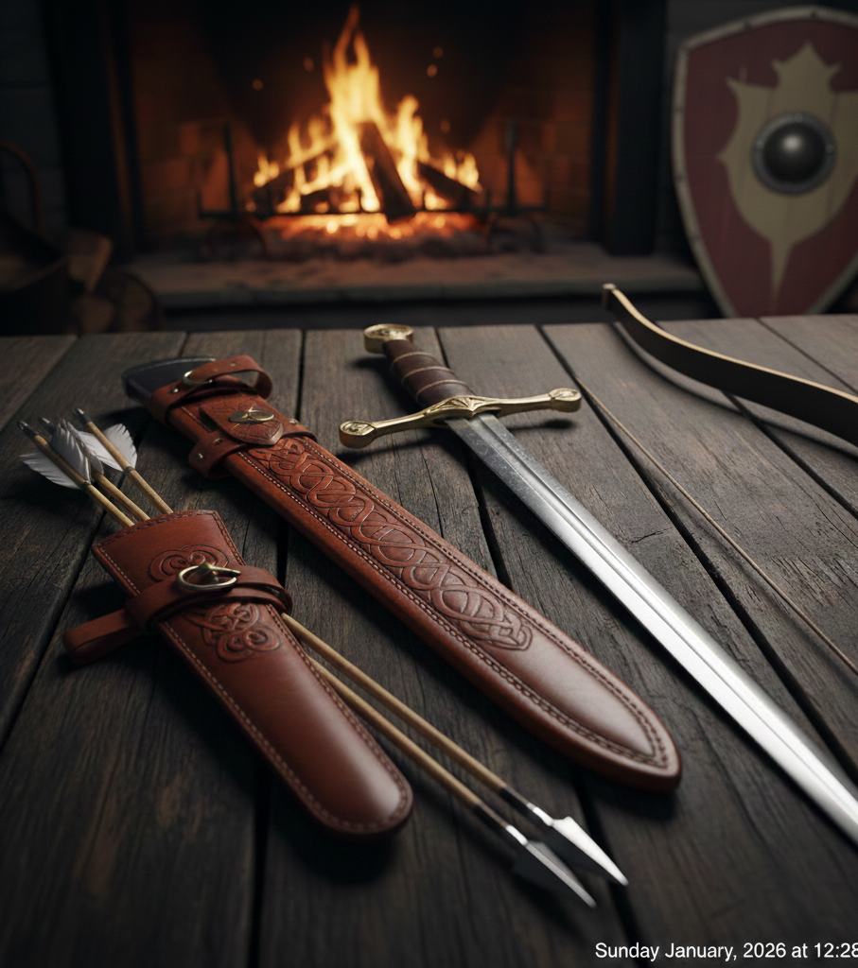
The cover is
your book’s
Greatest
weapon
against its competitors
and its
Greatest
advocate
in the marketplace.
Notes:
The cover is your book’s greatest weapon against its competitors, and its greatest advocate in the marketplace.
Your book cover determines whether you:
Are taken seriously as an author
If your book sells itself or drives people away
And whether it gets snatched off the shelf or left to collect dust.

Slide 23
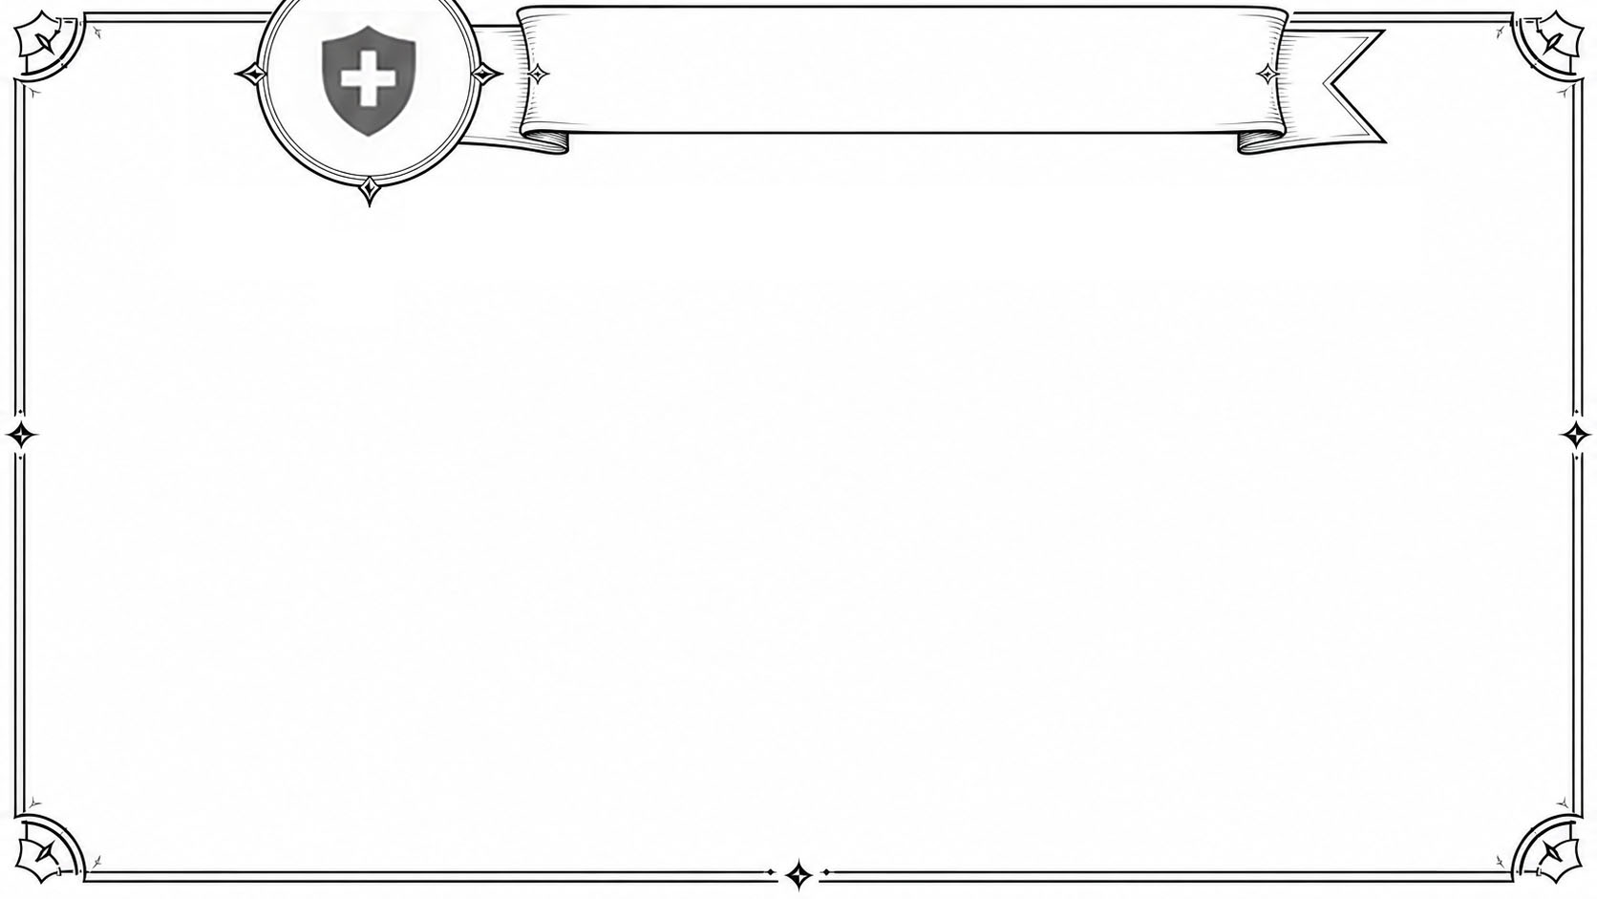
Part 2: choose your stats
“Good Marketing
Helps a Bad PRoduct
Fail FasTer.”
- Bill Bernbach
Notes:
The legendary advertising executive Bill Bernbach has a brilliant quote: “Good marketing helps a bad product fail faster.”
So before you launch, make sure your platform is healthy and your product is excellent. You don’t want to start out with low health.
You can trick someone into buying book one with a great cover and a strong launch, but they will only buy book two if book one delivered on its promises.
The goal is not just to turn a browser into a buyer. You must also turn a buyer into a fan. Fans are how your launches get stronger and stronger over time, building your kingdom.

Slide 24
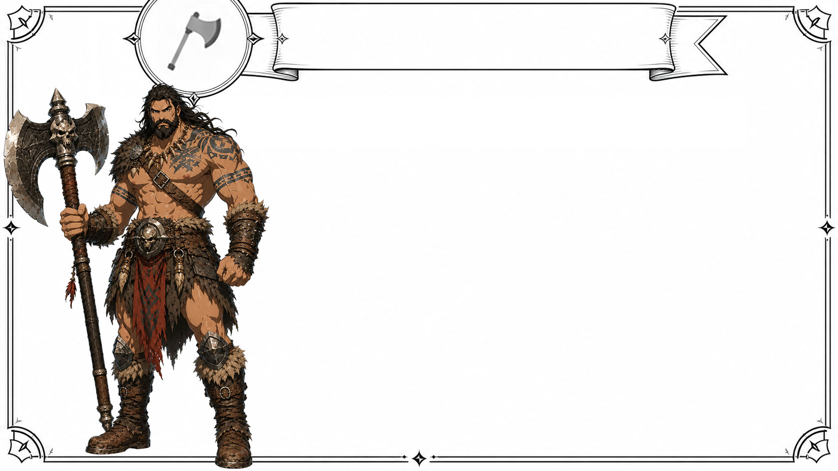
Part 2: choose your stats
strength:
paId
PRomOtioNs
Notes:
Your first optional stat is strength, which is paid promotions.
Who likes to stack the strength stat and play the barbarian who smashes everything?
Paid promotions can barrel through with results regardless of your platform size, assuming the book cover and synopsis are strong.
Which is useful because not everyone has a huge audience, especially at first. Paid promotions let you borrow someone else’s audience.

Slide 25
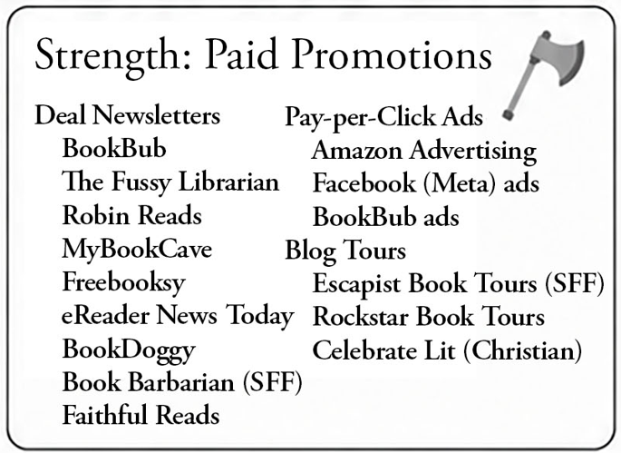
Part 2: choose your stats
Notes:
This includes book deal newsletters like BookBub, Faithful Reads, Robin Reads, The Fussy Librarian, MyBookCave, Book Barbarian, and others.
The concept is simple: they have a list of readers who want book deals. You pay for your book to appear in their email newsletter that gets sent to their list.
These can work especially well for discounted ebooks, series starters, and books with strong covers and clear genre appeal. I like to offer the first book in a series for free and return it to full price the next day. This is called “freepulsing,” but also consider other pricing strategies such as price pulsing to a cheaper price for a limited time, preorder bonuses, special offers for holidays, or put book 1 on sale when you release book 2.
Some people will open the email a day late and buy your book regardless. Then you can expect a “sales tail” where sales on books 2 and 3 roll in over time. Then you can hope to get lucky and find a super fan who will gladly buy all of your other books at full price.
But test them out and do the math to ensure they are profitable. Some may not earn out, but could still be worth it if your goals are reviews, ranking, your read-through rate, or the growth of your own newsletter.
Then we have pay-per-click ads, such as Amazon and Facebook ads, and also promoted posts on other socials. These can work, but they have a high learning curve. Amazon ads are the best place to start if your book has a really clear genre, which is hopefully a large and popular genre, and a striking cover. Facebook ads can work well when you know exactly who your audience is and have strong visuals and copy.
But ads can also eat money quietly in the background, so I recommend learning up on this or hiring a specialist.
There are also blog tours, which some people say are dead. It’s true that they are not what they used to be, but in certain genres and circles, especially Christian fiction, they can still help. Services like Celebrate Lit can be beneficial.
So, strength is useful when you have the budget for it and you’re willing to take the risk and learn how to do ads. A barbarian with an axe is powerful. But a barbarian with a blindfold is just property damage.

Slide 26
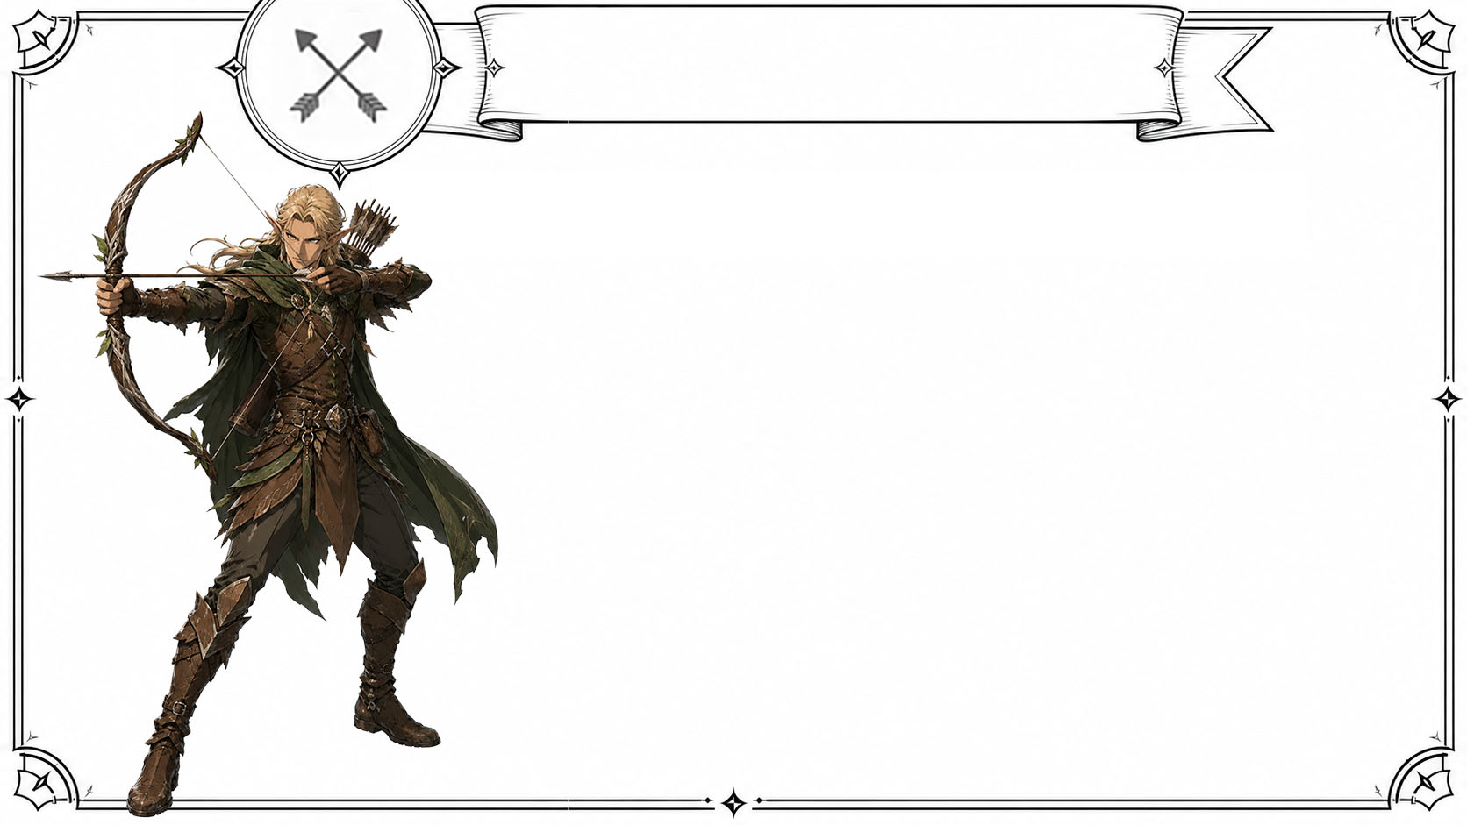
Part 2: choose your stats
agility:
offlinE
MarKetinG
Notes:
Next is the Agility stat, which represents offline marketing. Marketing your real, actual, physical books to real live people at real live places is strategic, focused, and often surprisingly effective. It’s agile because you target specific places where your readers already are. And quick, because most events last less than a day.

Slide 27
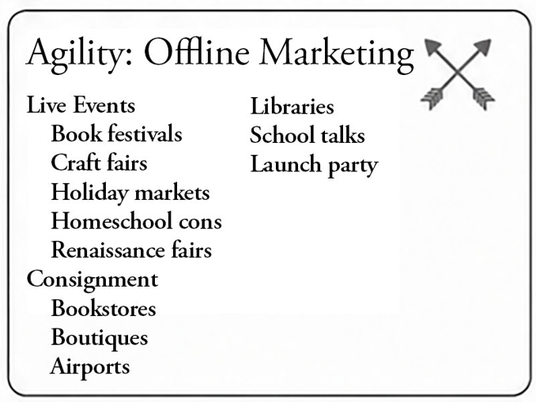
Part 2: choose your stats
Notes:
This includes live events such as book festivals, craft fairs, holiday markets, consignment at bookstores and other shops, libraries, school talks, launch parties, and local community opportunities.
Selling in person has several major advantages including instant feedback. Online all you see is analytics with clicks and impressions. In person, a twelve-year-old can look at your dragon book and say, “That looks boring,” and emotionally devastate you in a way that improves your career if you are humble enough to listen.
Other advantages are removing the middle men to make more profit per sale, you can sign and personalize books, you can include swag and sell other items on the side, and you can connect more deeply to your audience and enjoy increased sales as people search for gifts during the holidays, and more.
Consider hosting a launch party, either in person or virtual. You can do a reading from your book, a Q&A, serve food themed for your book’s genre, do games, giveaways, and invite other authors to participate and bring their fans.
I just gave an hour-long class with tons of details about how to be a boss at offline marketing, so if you want to know more, you can ask anyone who was there for their notes.
Who was at my last class? Please raise your hand. These people are your new best friends.

Slide 28
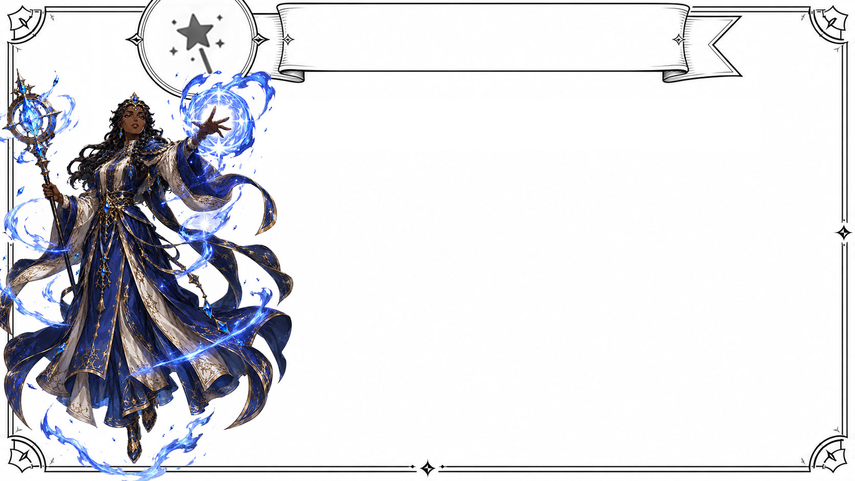
Part 2: choose your stats
magic:
sociaL
MediA
Notes:
Now let’s talk about Magic.
Social media is magic because sometimes it works spectacularly. And sometimes it just sets your hair on fire.
When social media works, it can work big. But that is rare. More often, it is fleeting, unpredictable, and mentally dangerous if you let it become your master.
Social media is often better for connection and announcements than direct sales. If you think Instagram is your ticket to the bestseller list, you will most likely be disappointed. Think of it instead as a way to foster and build relationships with readers so they will buy your future books.
And remember that social media is rented land. Your goal should be to move interested readers toward your owned platform: your email newsletter.

Slide 29
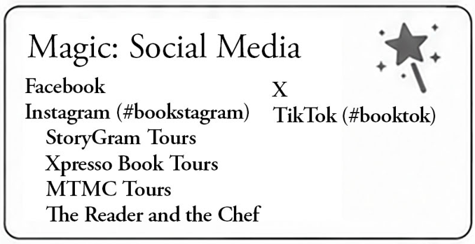
Part 2: choose your stats
Notes:
Some people insist you must be on every platform, especially whatever is the new one! Some 17-year-old just invented a new one called Florb and everyone must instantly get on it!
Contrary to popular belief, you do NOT need to be everywhere. You need to be where your reader is, and you need to be sustainable.
Facebook often leans older and more female. It can be useful for reader groups, book clubs, author pages, local events, and certain Christian fiction audiences. Check out Avid Readers of Christian Fiction by my friend Tricia Goyer.
Instagram often leans younger and visual. It can be good for fantasy, romance, YA, beautiful books, aesthetics, reels, cover reveals, quote graphics, and reader connection. Check out StoryGram Tours, Xpresso Book Tours, MTMC Tours, and The Reader and the Chef.
TikTok leans younger and can be powerful for books with strong emotional hooks, tropes, personality-driven content, and genres that thrive on reader enthusiasm. Check out BookTok.
X tends to lean more male and argumentative. It may have uses, but approach with the caution of someone entering a tavern where everyone has knives and opinions.
YouTube and podcasts can be excellent for nonfiction authors, teachers, and anyone whose expertise is part of the product.
Or it might be more effective to leverage other online communities like forums, subreddits, Discord servers, and fan-blogs in your genre.
But you should choose ONE platform where your readers actually are and become good at it. Do not be terrible on six platforms.
And remember that social media is a wild, dangerous magic. Do not play the comparison game, read toxic comments, or build your entire launch on the hope that a post will go viral. Or the spell you’re trying to cast will burn you instead.

Slide 30
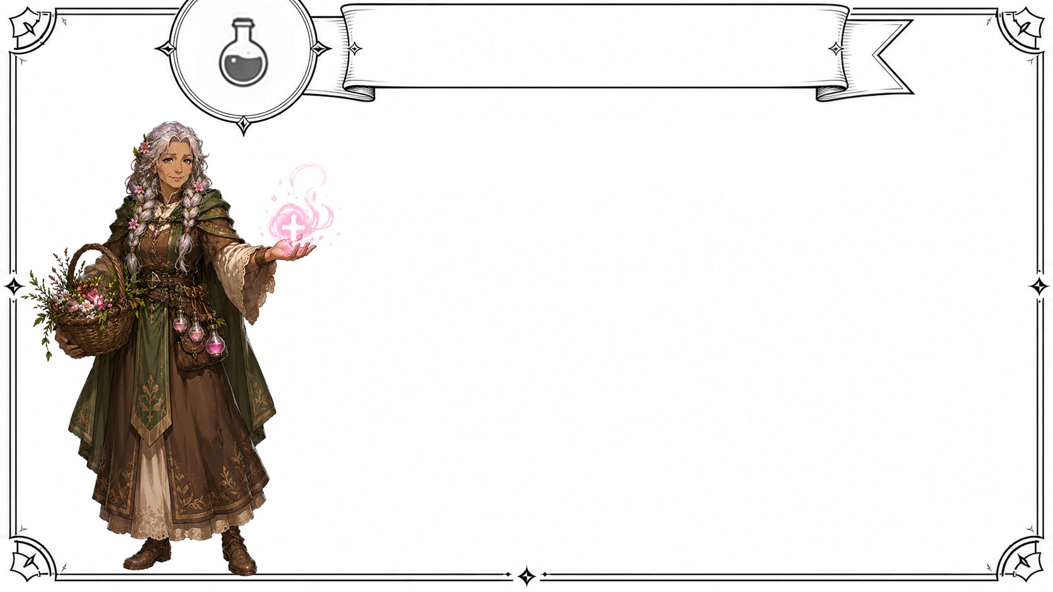
Part 2: choose your stats
charisma:
NetWorKing
Notes:
And now for my personal favorite stat: Networking. Getting to know and support other authors is one of the most underrated parts of book marketing. And this conference is the perfect place to do it!

Slide 31
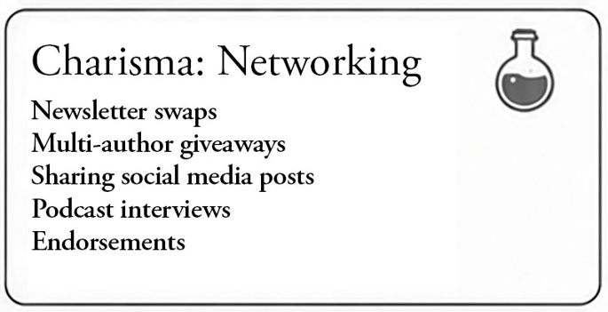
Part 2: choose your stats
Notes:
And I don’t mean sliding into someone’s messages asking them to promote your book when you’ve never met them in your life. I mean real, actual friendship, encouragement, mutual support, and a trusted place to ask questions.
Other authors can help through newsletter swaps, multi-author giveaways, launch team support, endorsements, podcast interviews, social sharing, and splitting booth costs. They might participate in your next virtual launch party and bring all their fans.
Authors do not really compete like competitors in other industries do. Readers read a lot faster than we can write. So when you promote another author who shares your audience, you are not losing readers. You are serving them. And when your next book comes out, that author may be happy to help you too.
So be a genuine friend. Be generous and celebrate other authors’ launches. Promote books in your genre that you think your audience would love. Endorse books that you honestly enjoy. Be present and patient, not pushy. Give without expecting anything in return.
And the benefits will be priceless.

Slide 32
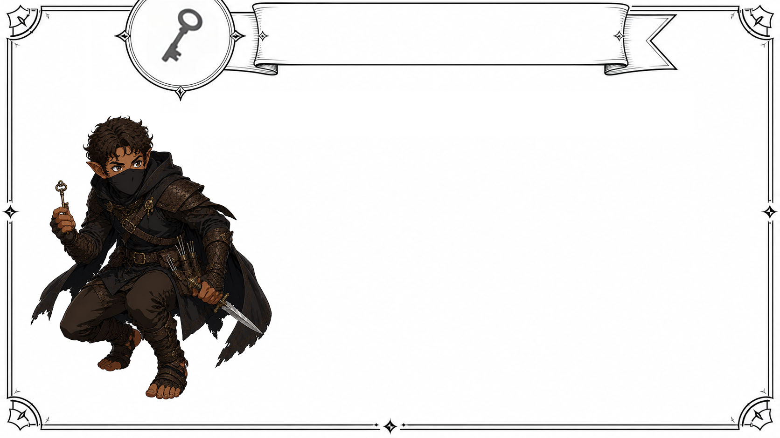
Part 2: choose your stats
skill:
SpeciaL
stRateGies
Notes:
And last but not least, our final stat is skill. This includes all the specialty tactics that can make a launch feel “extra.” These are not required, or right for everyone, but I’ll mention them because they can be powerful in certain situations.

Slide 33
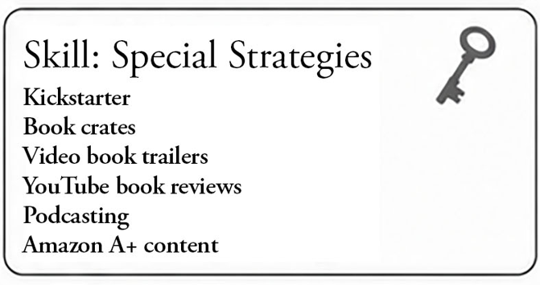
Part 2: choose your stats
Notes:
First is Kickstarter, which is its own beast called “crowd funding” where people pay up front for your book and whatever other awesome swag you’re offering.
It can be amazing for certain books, especially special editions, illustrated books, deluxe hardcovers, fantasy, games, art-heavy projects, and books with passionate niche audiences.
But Kickstarter is NOT easy money. It requires a lot of planning, tons of amazing artwork, reward tiers, fulfillment, shipping math that will eat your profits if you miscalculate, video, updates, and a lot of promotion before the campaign even begins.
To do it justice would require its own class, so do a lot of research before deciding if Kickstarter is right for you.

Slide 34
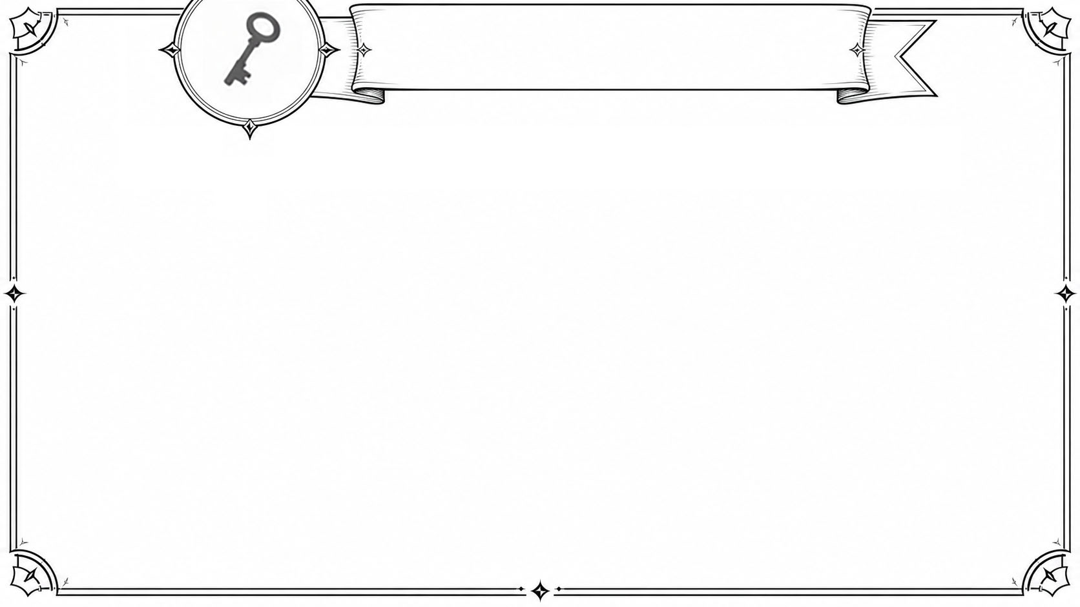
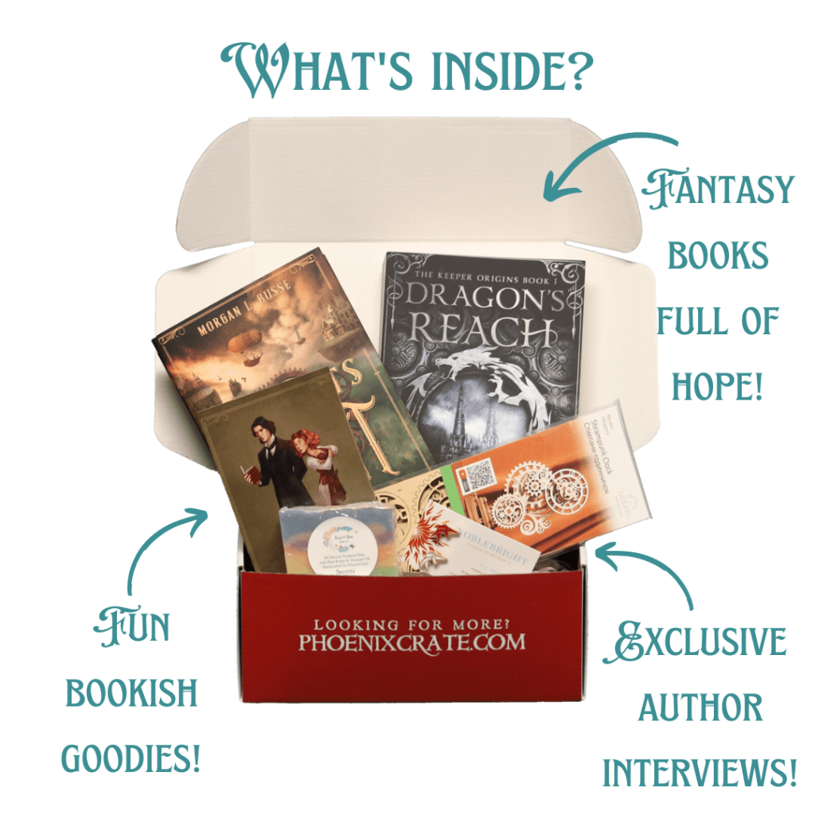
Part 2: choose your stats
Book
Crates
Notes:
Next, book crates or subscription boxes can be a great discovery tool, especially in YA, fantasy, romance, and genres where readers love beautiful physical editions and themed items.
But they usually require you to have a very polished product, strong packaging, and logistically it can be a big investment if you have to send the organizers 500 books. I recommend a postcard with your book cover and a QR code with a coupon instead.

Slide 35
Part 2: choose your stats
Notes:
Video book trailers. I’m going to be honest: most book trailers are not a great return on investment. They tend to be awkward and a lot of stock footage of fog or fire. So if you decide to do one, make it awesome, and make it short.
You could also make your own YouTube channel where you review books, or your own podcast where you talk about . . . well, anything book related. But these are both an enormous amount of work, so make sure you have the time and the passion first.

Slide 36
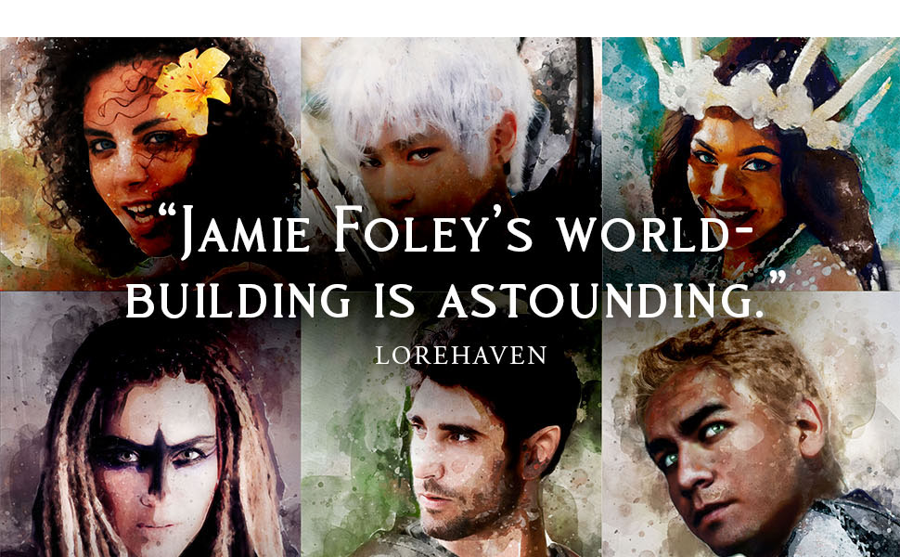
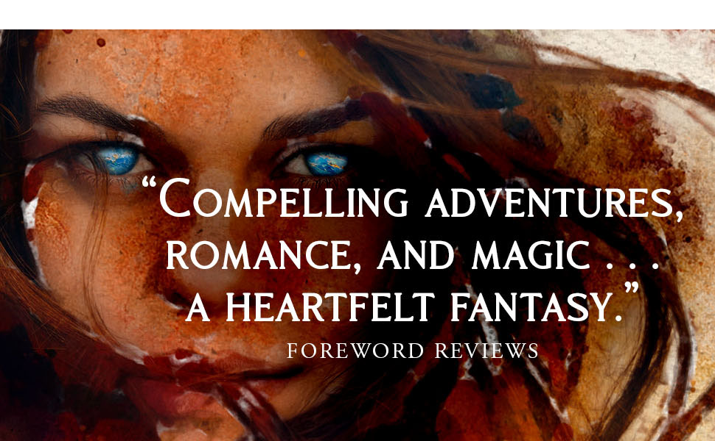
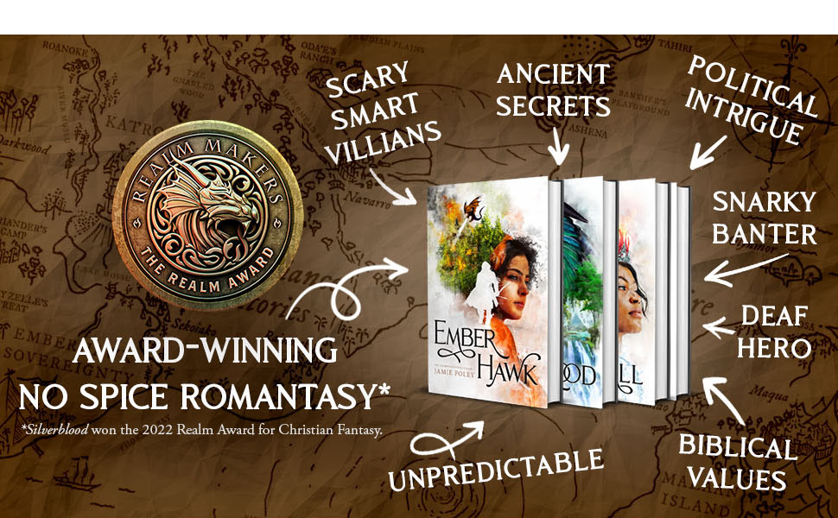
Part 2: choose your stats
Amazon A+
Content
Notes:
A+ content lets you add additional images to your Amazon book page. This can be especially helpful if you have strong visuals like character art or a map or endorsements. You can set this up for free to automatically make your book’s Amazon page feel more professional.

Slide 37
Part 2: choose your stats
Notes:
Whatever you do, DO NOT attempt to do everything on this sheet. You are not a wizard with unlimited spell slots. Choose a few things that make sense for you now, and you can attempt the shiny things further down the road. Look honestly at your current situation and determine which stats are naturally high for you. Play to your strengths.
A strong launch is not about doing everything. It is about doing the right things well.

Slide 38
P a r t 3
cReAte YouR laUNcH tIMelINe
Part 1:
Define Your Goals
Notes:
Once you have a vague idea of your stats, you can create your own launch timeline. You don’t have to do all of this right now, so this is your homework, OK? I know this is like drinking from a firehose, and that’s why I gave you these hand-outs and I’ll give you a link to download the slides and the character sheet at the end. You can go home and fill this out when you have some nice tea and candles to brood beside and sharpen your daggers.
For part 3, let me give you a simple outline to work from and fill out.
The timeline is divided into four basic phases: building your foundation, increasing visibility, the launch week, and keeping momentum. The dates are guidelines, not sacred prophecy. If your book comes out in six weeks, don’t panic. Just compress the timeline. The order matters more than the exact date.

Slide 39
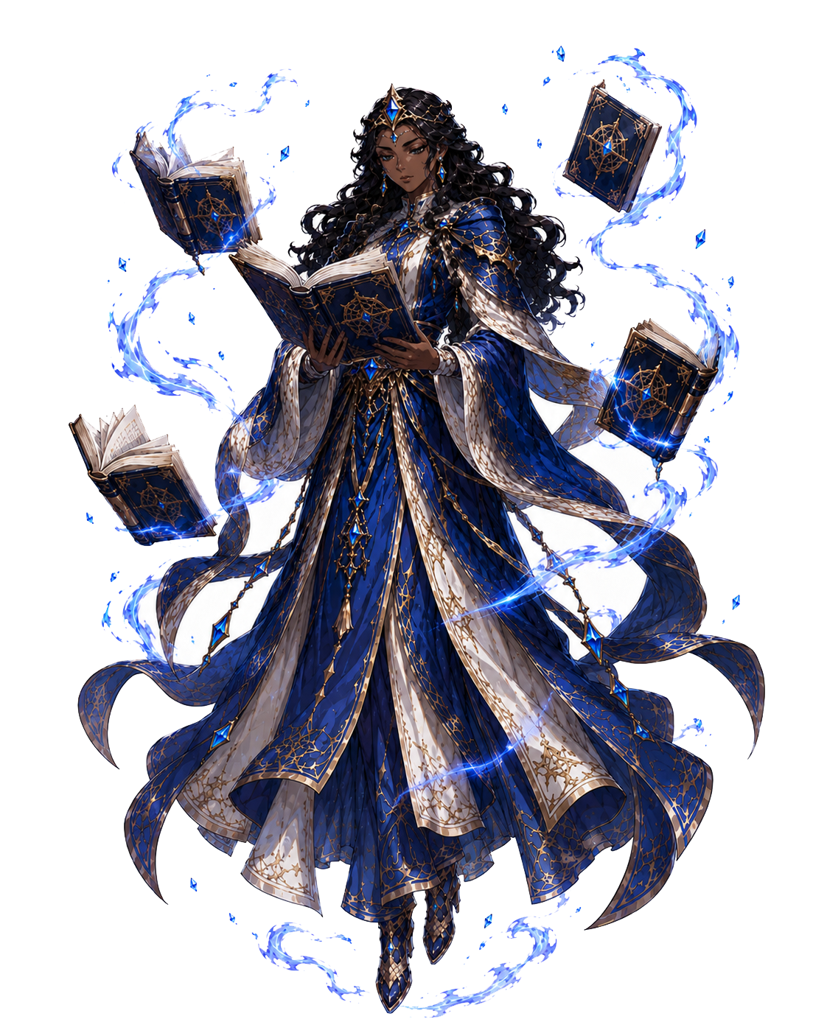
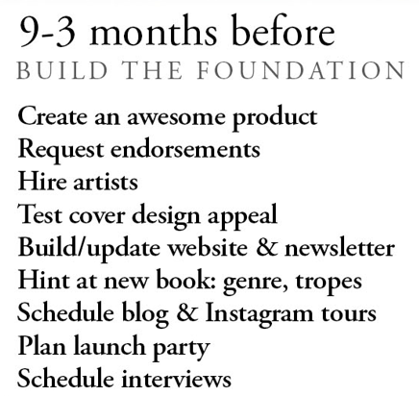
Part 3: create your timeline
Notes:
First, nine to three months before launch, build the foundation. This is where you create an awesome product, request endorsements, make sure the cover is strong, update your website and newsletter, and start hinting at the new book. You’re not asking people to buy yet. You’re letting them know something is coming. Build anticipation with hints at the genre, tropes, artwork, quotes, the map, lore--just to tease and excite your existing audience.

Slide 40
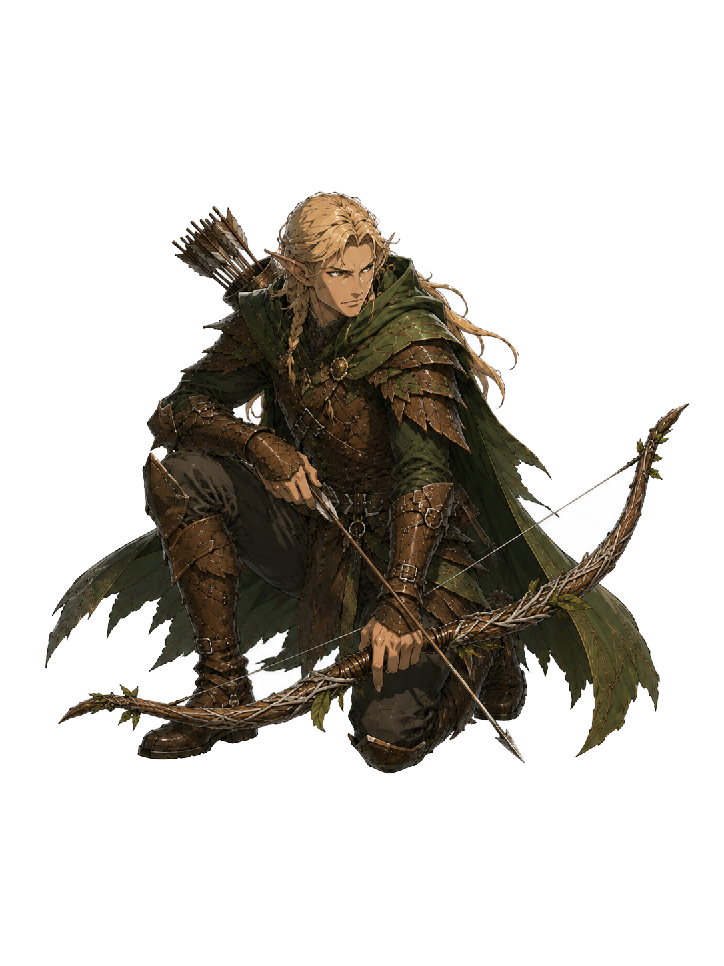
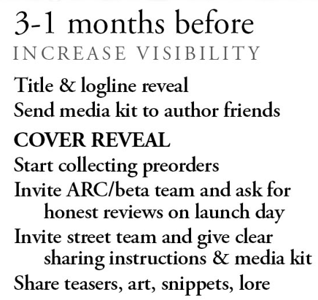
Part 3: create your timeline
Notes:
Then, three to one months before launch, increase visibility. This is where you start revealing things one piece at a time: the title, logline, and cover. Notice we’re not dumping everything on launch day. We should generate excitement and hype it up in little moments over time.
Your first major marketing ordeal is the cover reveal. It is such a big deal that many blog and Instagram tours will let you arrange TWO tours: one for your cover reveal day and one for your launch day. Ask your author friends and any helpers to share, and give them your media kit full of graphics. Give people clear instruction to preorder, share, or join your street team who will share on your launch day in exchange for perks.
Then you invite your beta team, also known as an ARC team. This stands for Advance Reader Copy. Give them enough time to actually read the book. A month is a good general minimum, especially if your book is big enough to be a melee weapon. Ask politely for honest reviews on Amazon, Barnes & Noble, Goodreads, or wherever reviews matter for your strategy. Send more ARCs to reviewers, bloggers, or influencers.

Slide 41
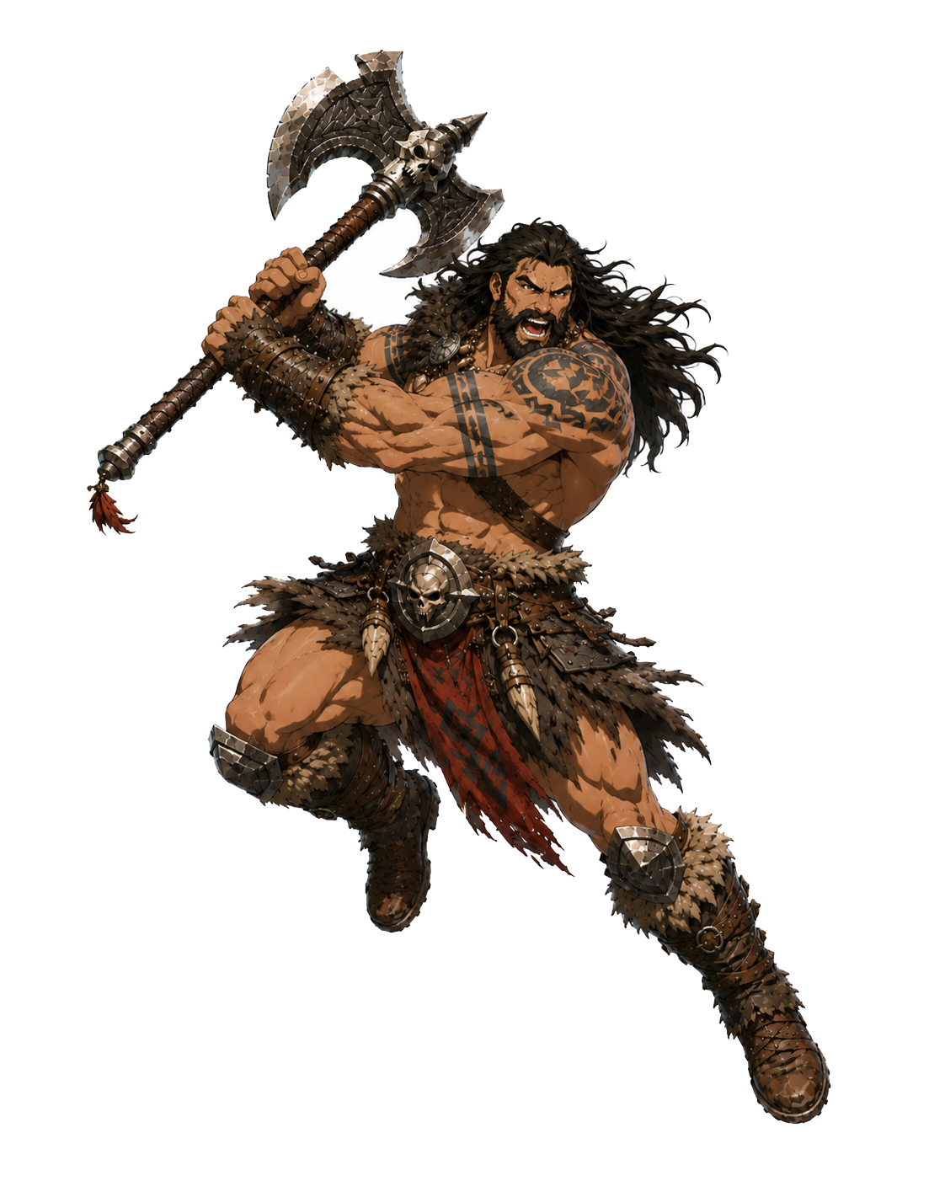
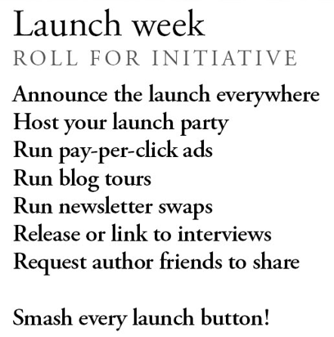
Part 3: create your timeline
Notes:
Then comes launch week. This is when you roll for initiative, set thrusters to full, and hit all the red buttons.
Announce the launch everywhere. Host the launch party. Run the promotions you already scheduled every day for the first week, or two weeks if you can. Remind your launch team to leave reviews. Have something happening every day if you can, even if it’s simple.

Slide 42
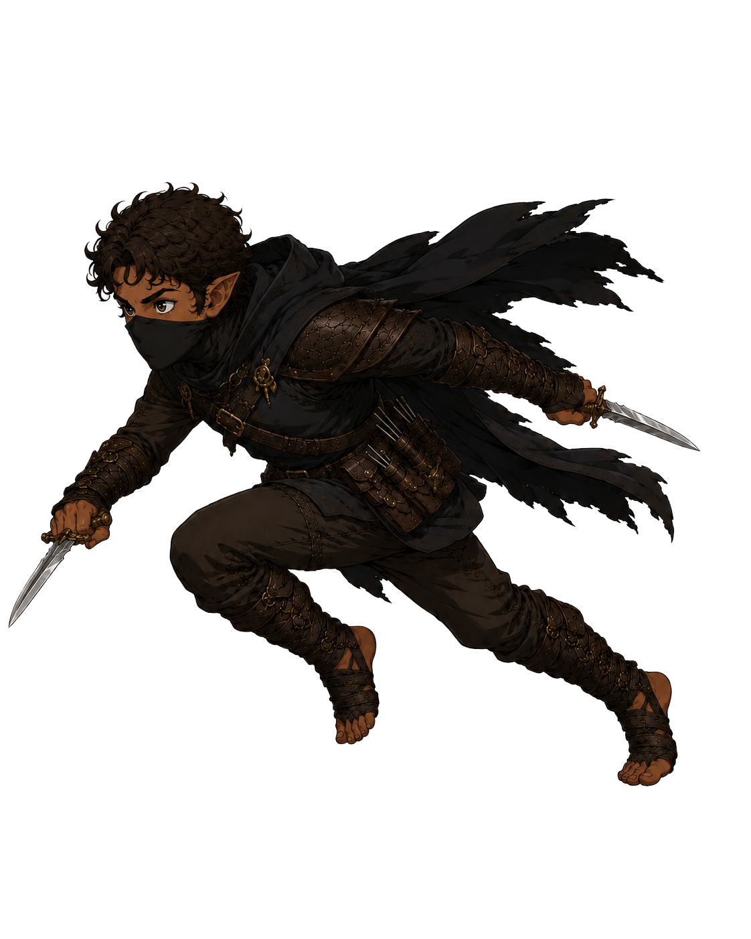
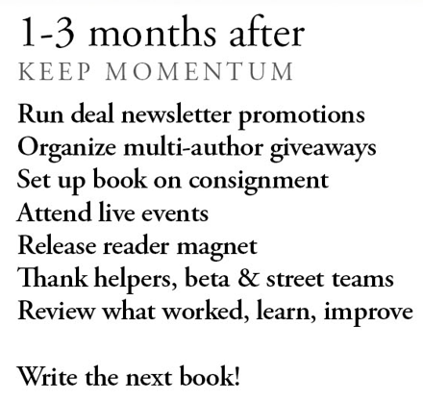
Part 3: create your timeline
Notes:
Then, one to three months after launch, we need to keep up momentum as long as we can. Release a reader magnet to get as many people on your newsletter list as you can, so your next launch can be that much bigger. Follow up for honest reviews and send thank-yous and goodies to your beta and street teams and everyone who supported you. Analyze what worked, what was a waste of time, and what you’ll do differently next time.
And finally, after you have thoroughly celebrated and rested from your hard work, write the next book.

Slide 43
Notes:
A strong launch isn’t about maxing out every stat. It’s about knowing where you’re weak, choosing where you’re strong, and doing what you can with excellence.
Because the secret to a successful long-term writing career is to focus on serving your readers and striving to do everything with excellence.
Now, is it okay if I say a quick prayer?
Lord, I thank you for the creativity you have gifted to everyone in this room. I ask that you would draw near to us with your Holy Spirit and bless our efforts to bring joy and truth to others through our stories, and that you would be glorified through our writing. Please bless all of us with your presence, protection, and wisdom. I ask for both humility and confidence for us in our writing and marketing, and I pray against stress and the dark forces that would seek to hinder us.
In the name of Jesus, I ask these things. Amen.

Slide 44
Notes:
All right, that’s it. You may now throw your tomatoes.

Slide 45
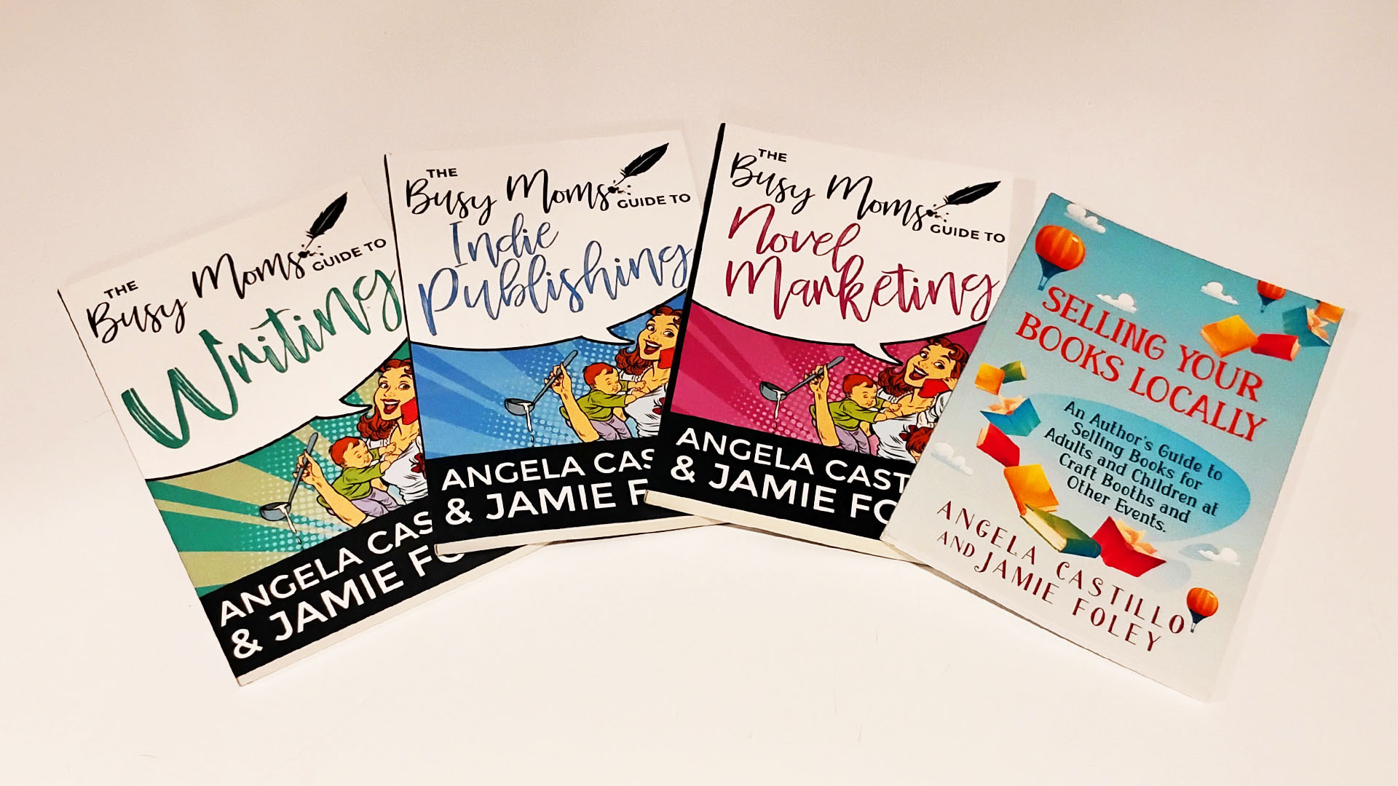
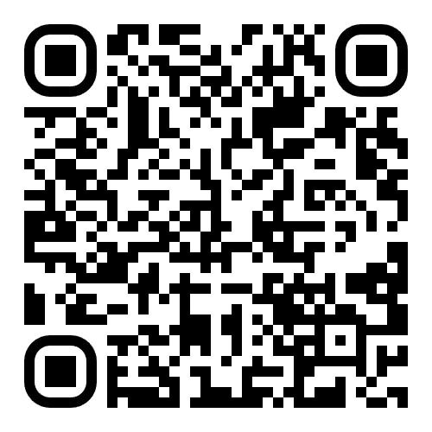
Notes:
If you want more of my long-winded advice, I’ve stuffed many gems into The Busy Mom’s Guide to Writing series. In these you can also find out how to avoid all the potholes I fell into when I first started writing, publishing, and marketing.

Slide 46


www.JamieFoley.com/
Events/LevelUp
Notes:
Or if you’re a nerd like me, check out my award-winning sci-fi/fantasy novels on my website, JamieFoley.com. All of my books are available for sale at the Fayette Press booth in the vendor hall, and I’d be very happy to sign them for you. *WINK*
Here is the QR code and link to download the slides and the printable character sheet, which will be active only for the next 2 weeks. I apologize if I spoke too quickly and stressed y’all out. Do we have time for questions?

